Slide 1
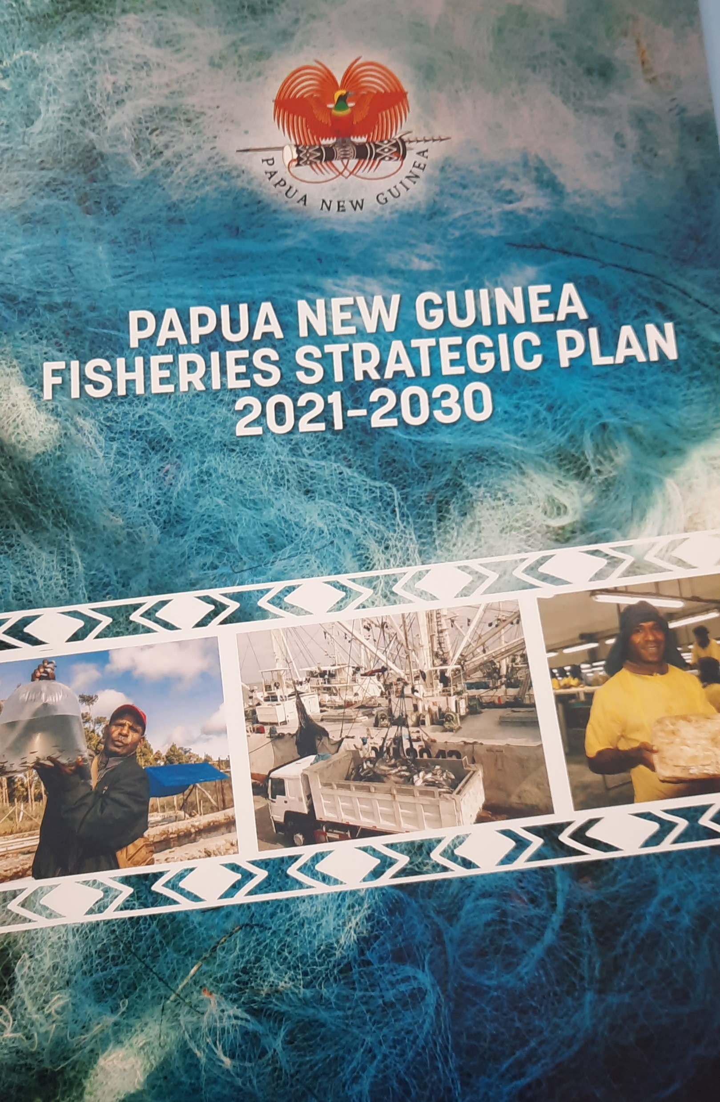
Papua New Guinea National Tuna Fishing Industry Consultation
Holistic Tuna Fisheries Development
How do we do it?
23-24 February 2022, Hilton Hotel, Port Moresby

Slide 2
Outline
Objectives of the FSP 2021 – 2030
FSP Framework: Strategic Outcomes
Vision
Mission
How do we do it?
The Key Result Areas
Conclusion

Slide 3
Fisheries sector in national planning framework
To reliably inform government planning process.
To promote the fisheries sector as a strategic asset.
To give due recognition to the growing importance of aquaculture & inland fisheries.
To give due recognition to growing values of ocean, seas, rivers and lake resources as pillars for sustainable growth.
To align fisheries sector to the Constitution and the sustainable goals of the StARS
To elevate fisheries sector to a higher level of strategic consideration

Slide 4
PNG fisheries Strategic plan framework
Economic returns to the economic
Participation of citizens
Accountable & effective Governance
Healthy state of aquatic, oceans & coastal environments are maintained

Slide 5
Vision
To achieve:
“An internationally competitive and sustainable sector and fishing industry characterized by a resilient and commercially inclusive socioeconomic growth providing food security”

Slide 6
Mission
To ensure that:
“Papua New Guinea’s fisheries sector is developed into a strong, broad based, diversified and value-adding industry that is globally competitive; domestically inclusive and functioning as a robust and sustainable source of government revenue, food and livelihood for the people.”

Slide 7
How do we do it?
By focusing on 11 Key Result Areas or priorities for the next 10 years

Slide 8
The Key Result Areas (KRAs)
KRA 1 | Enabling infrastructure & industry operating environment | Investment in wharves, ports, jetties, slipways, onshore facilities to enhance industry competitiveness
KRA 2 | Optimize government revenue | Generate sustainable economic benefits, create wealth, government revenue
KRA 3 | Processing, value adding, employment, export earnings | Broad economic benefits: Expand productive capacities, supply chain opportunities, product development, markets
KRA 4 | International trade & market access | Improve market access and beneficial trade agreements
KRA 5 | Foreign direct investment | Maintain and improve conducive policy and regulatory environments
KRA 6 | PNG participation & local content | Enable citizens to have greater control of the bulk of the economic enterprises ad production
KRA 7 | Food security & livelihood opportunities | Accessible, readily available and affordable source of protein, food security and to support livelihoods
KRA 8 | Research, extension support services, training, capacity building | Remain relevant, proactive and fully equipped to improve service delivery
KRA 9 | Sustainable fisheries mgt & healthy ecosystems | Long term sustainable development of the sector is contingent on a well managed fishery & healthy ecosystems
KRA 10 | International fisheries cooperation & engagements | Protecting and promoting PNG’s interests in a fast changing geopolitical landscape
KRA 11 | Evidence based policy & planning approach | The need to credibly inform the decision making process

Slide 9
We need your support
Regional partners
Industry players
Provincial Governments
Resource owners
Government departments
Development partners
Donor agencies
Service and utilities providers

Slide 10
Thank you !

