Slide 1
integrated FISHERIES INFORMATION AND MANAGEMENT SYSTEM (iFIMS)
PNG FISHING INDUSTRY ASSOCIATION (FIA)
Fisheries Sector
Connecting value added products to high-end markets
Herman Kisokau

Slide 2
PILLARS
PNG FIA Office and Members use iFIMS Web Portal as management tool to implement Responsible Sourcing Policy
Marine Stewardship Certification (MSC) https://fisheries.msc.org/en/fisheries/png-fishing-industry-associations-purse-seine-skipjack-yellowfin-tuna-fishery/@@view
Fishery Traceability
Marine Litter and Fishing Gear
Social Accountability

Slide 3
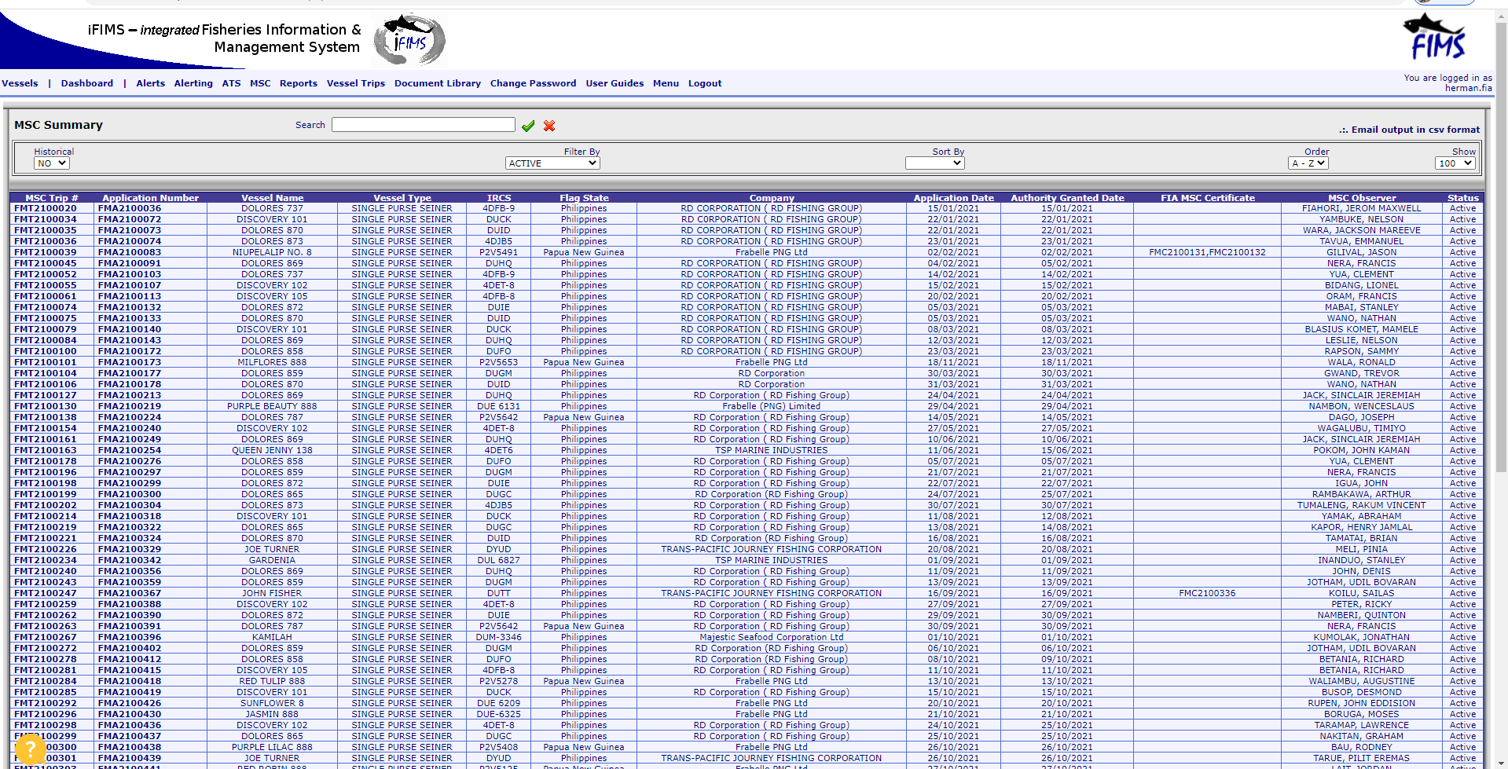
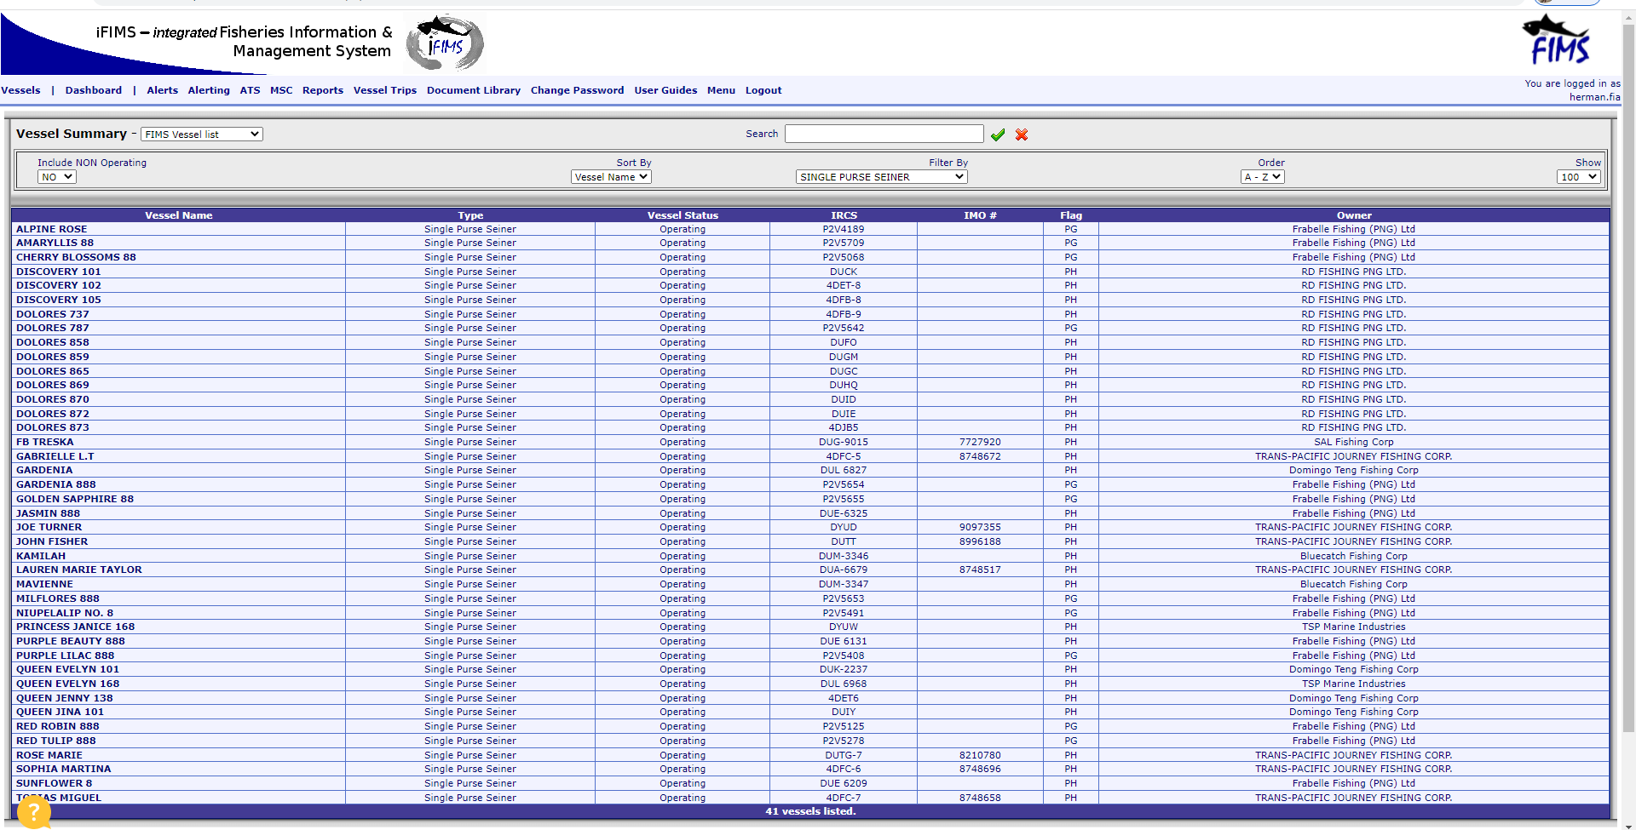
PILLAR NO.1
MSC
Notes:
PNG FIA LIST OF VESSEL ON MSC CERTIFICATE CREATED AND

Slide 4
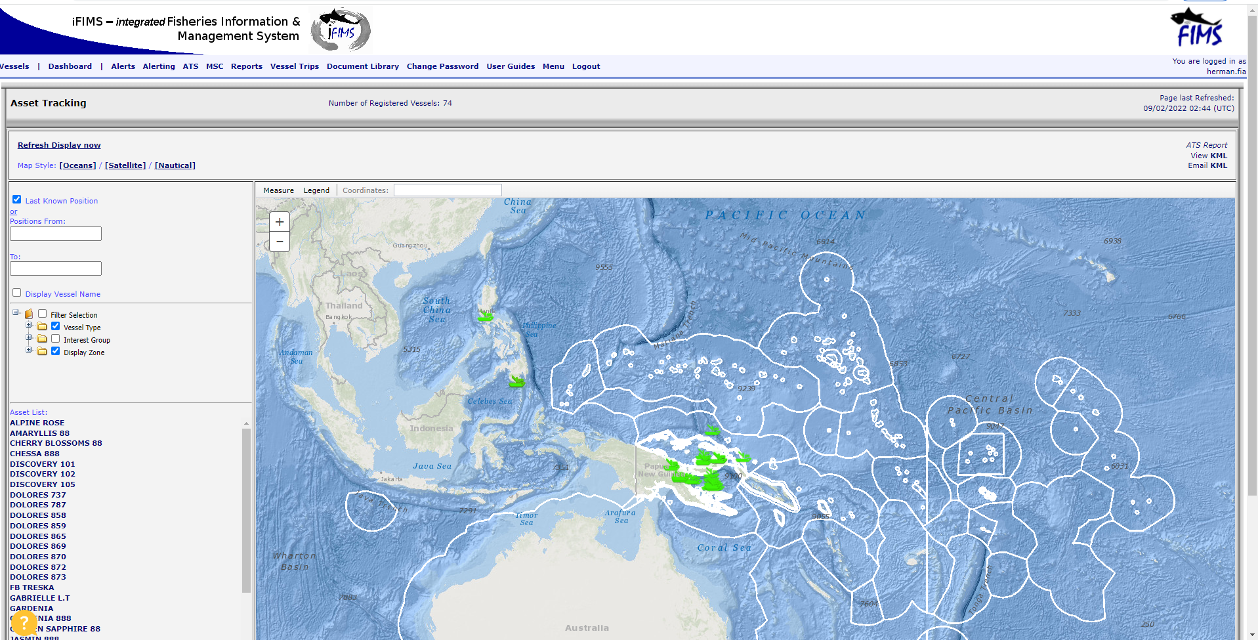
PILLAR NO.2
FISHERY TRACABILITY

Slide 5
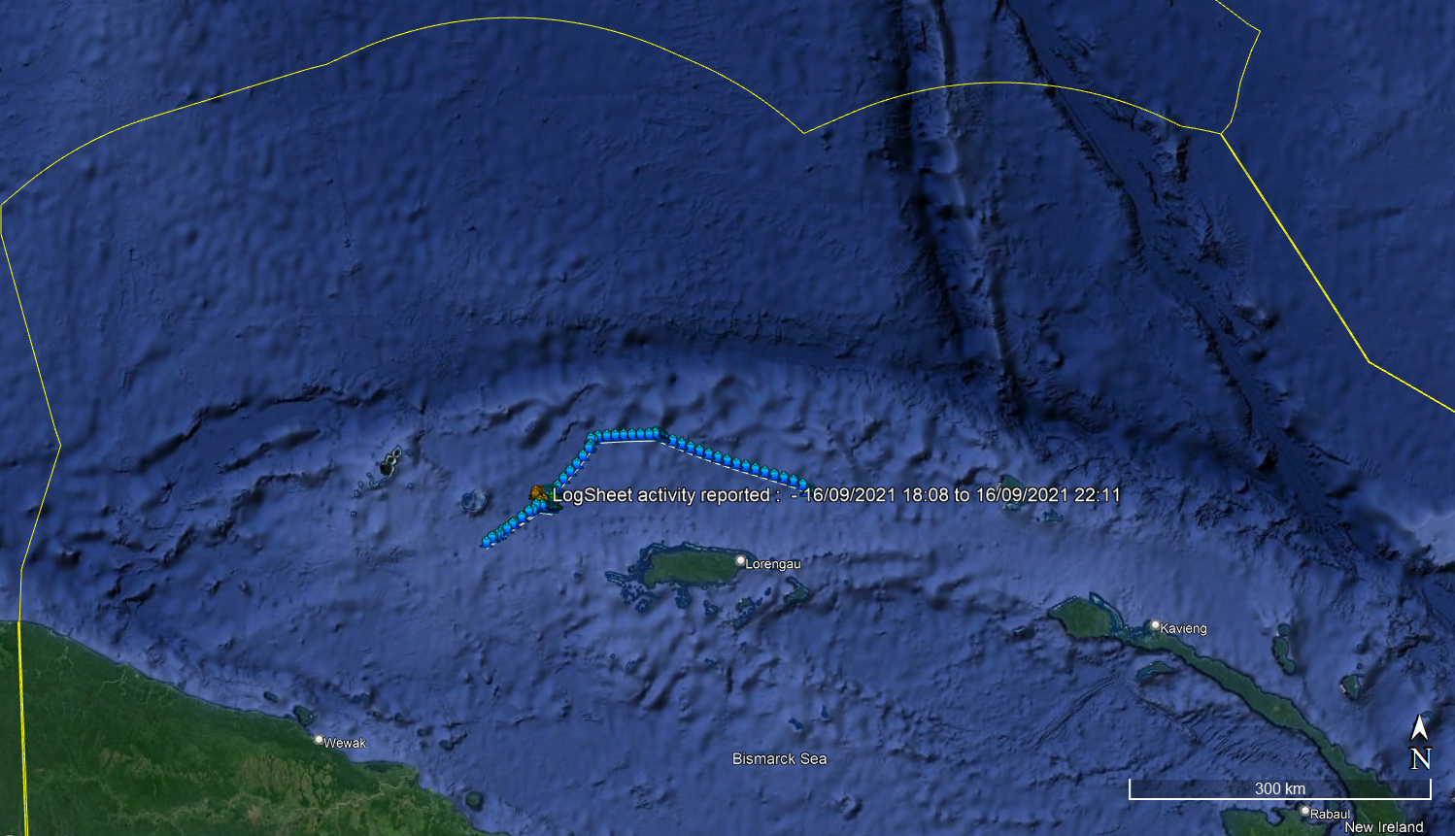
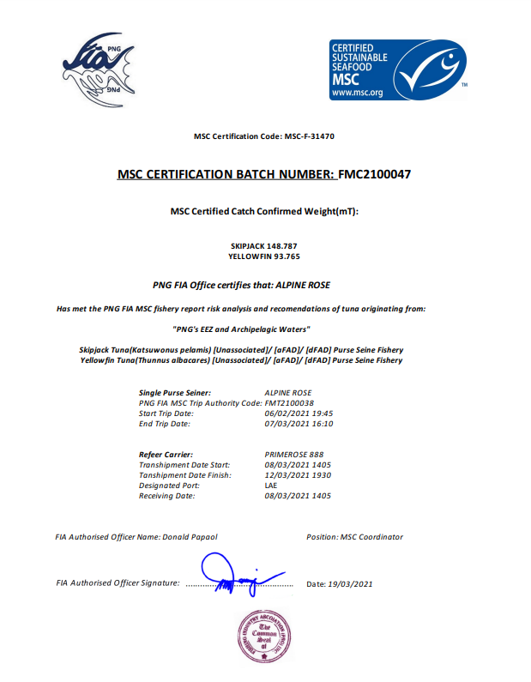
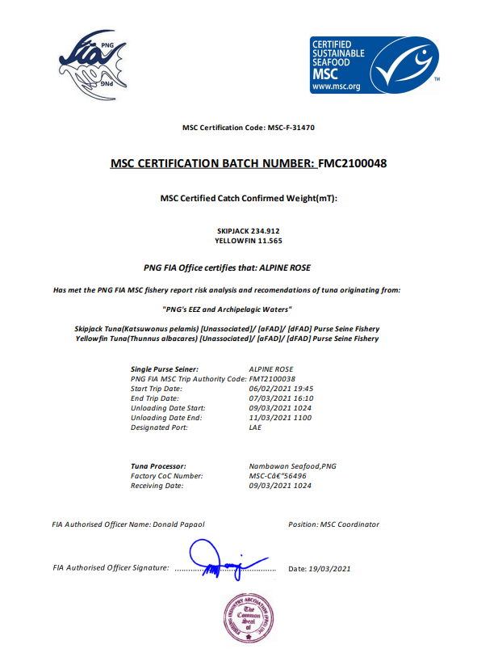
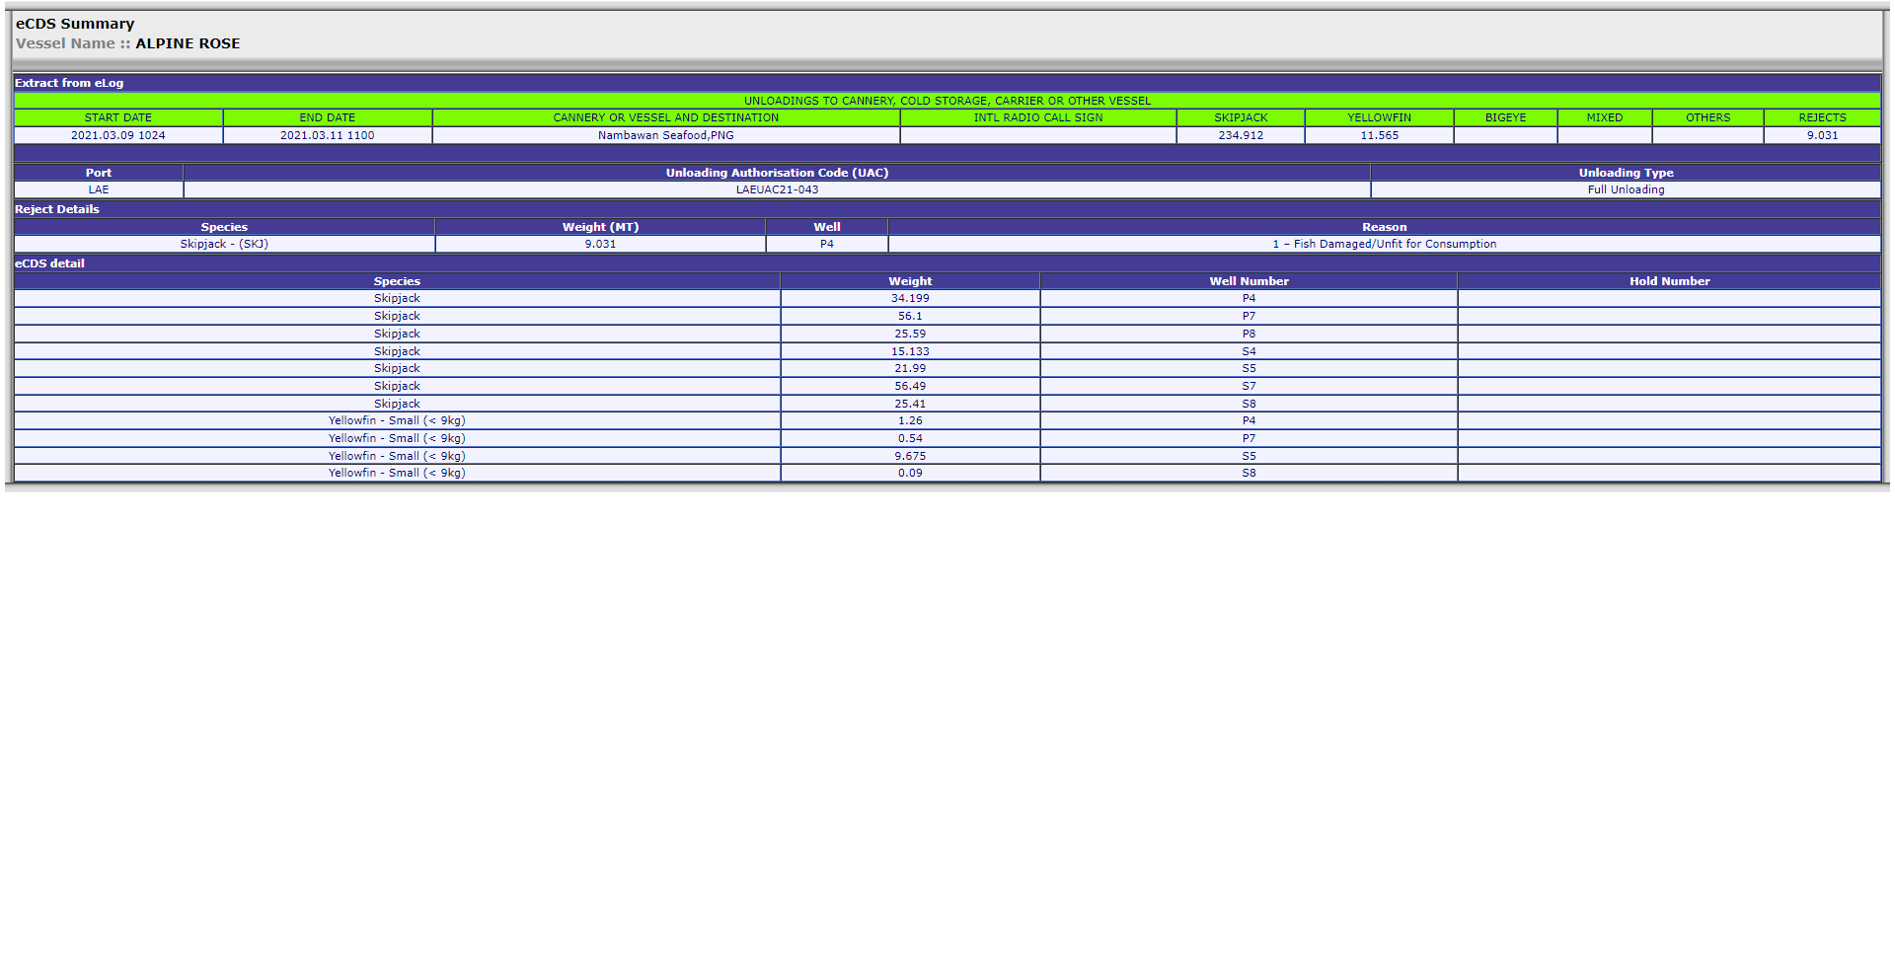
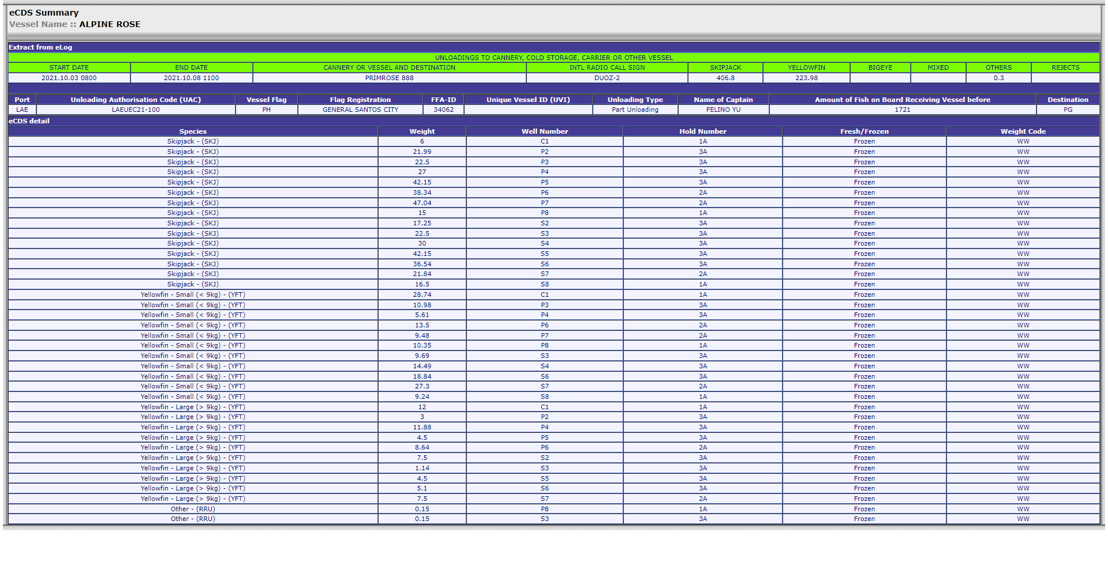
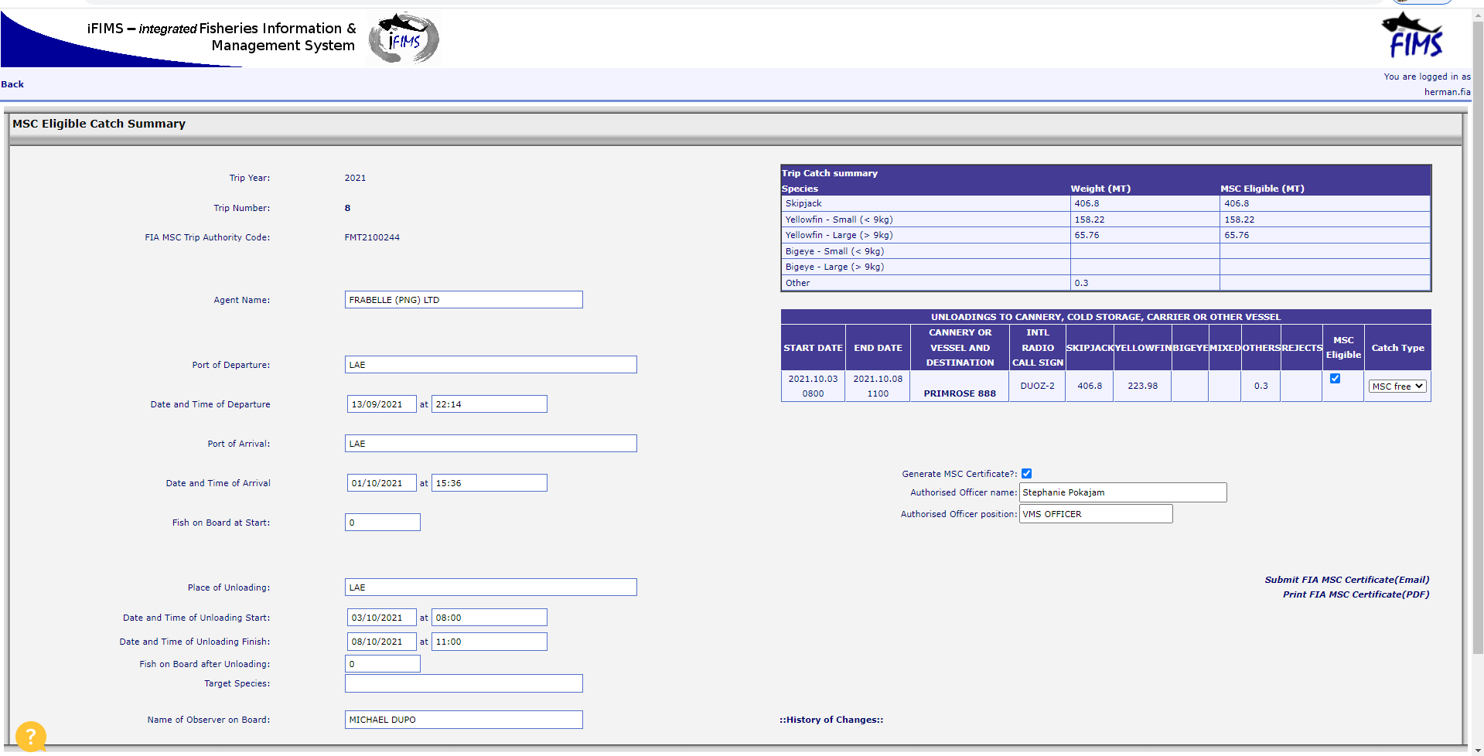
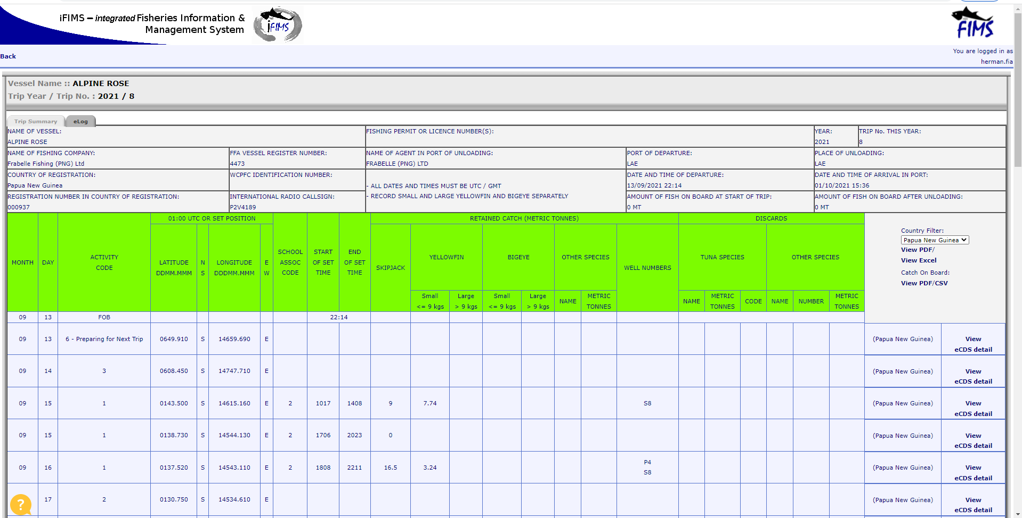
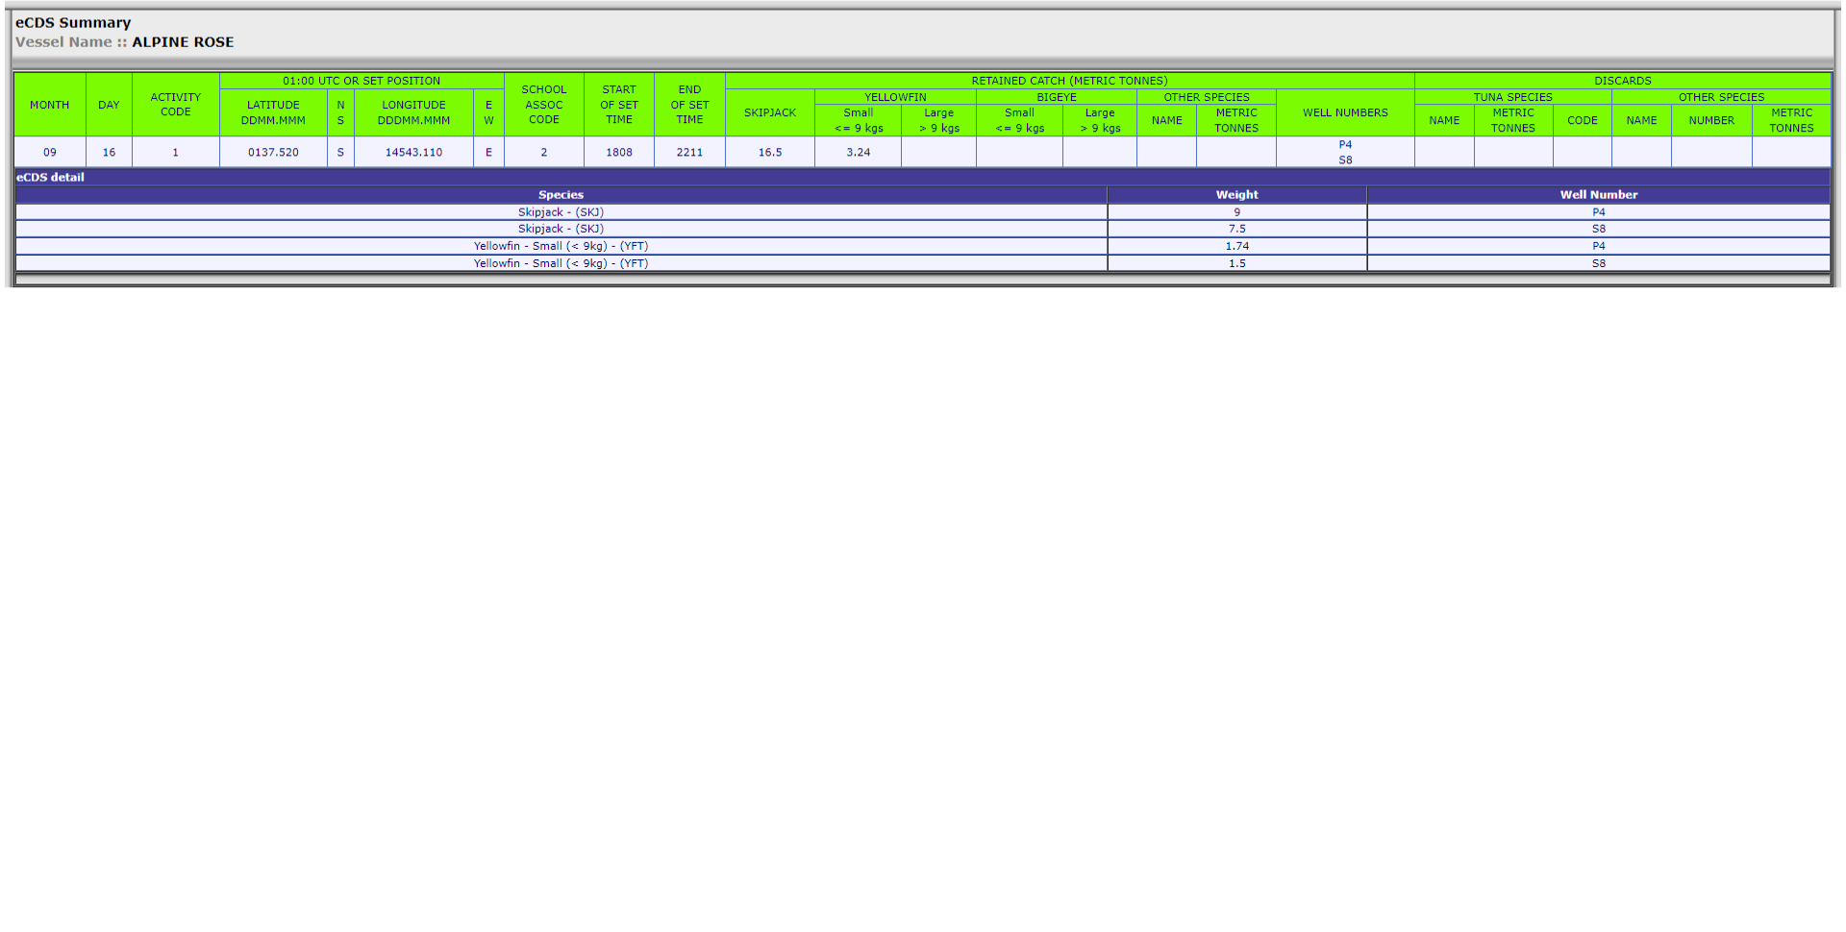
MSC CATCH ELOG

Slide 6
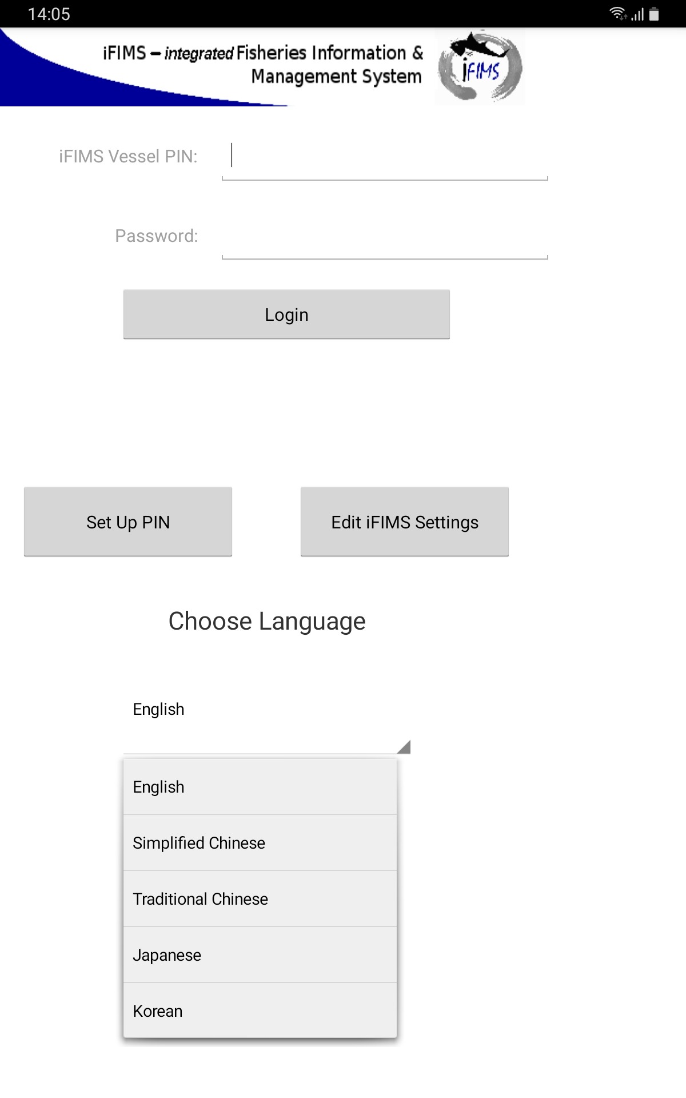
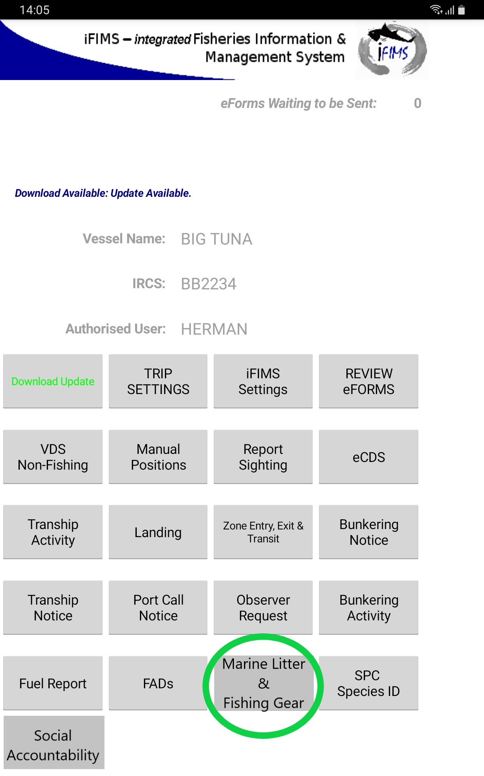
PILLAR NO.3
Marine Litter and Fishing Gear
Members fishing vessels have NFA Fisheries Observers on board during MSC Fishing Trips and collects data on MARPOL. Our vessels demonstrated compliance in this area.
FIA continue to enhance existing iFIMS Industry Android App to collect data for our members.

Slide 7
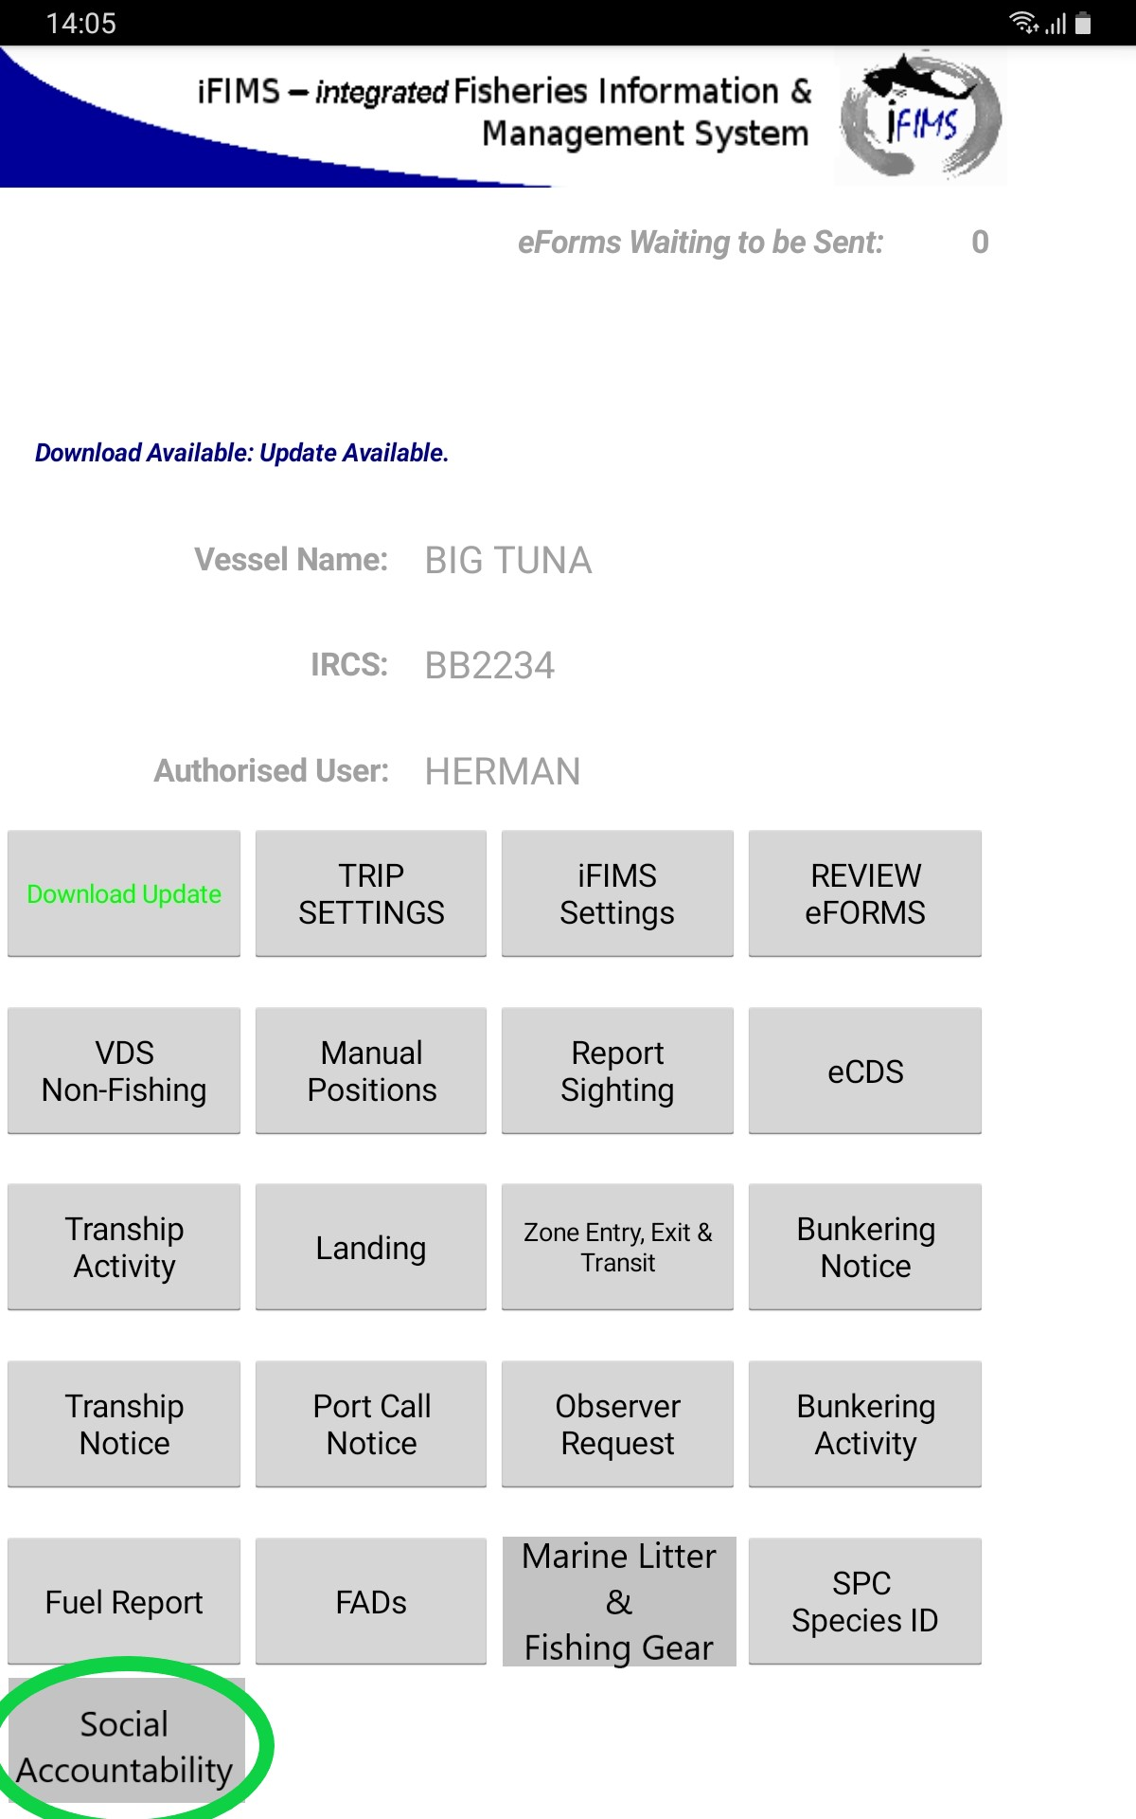
PILLAR NO.4
Social Accountability
Members fishing vessel provides data to PNG Law Enforcement Port Inspectors during vessel inward/outward clearance of every fishing trip.
FIA committed to enhance existing iFIMS Industry Android App collect data on ILO Indicators of Forced Labour.

Slide 8
Thank you!

