Slide 1
National Tuna Industry Consultation Meeting
23 – 24 February 2022, Hilton Hotel, Port Moresby
Theme: “Holistic Tuna Fisheries Development. How do we do it”
Topic: “A Re-look at the Growth of the Fishing & Processing Industry”
Sylvester Pokajam | President and Chairman FIA PNG Inc.,

Slide 2
Content:
Introduction of Fishing Industry Association (PNG) Inc., (FIA-PNG)
Domestic Fishery - Background (1960s to 1980s)
Growth of the Fishing Industry – 1970s to 1980s
Fast-forward – 1990s to 2000s
PNG Fishing Industry Operation (purse seine fishing)
PNG Tuna Processing Industry (canning, loining, fish-meal and fish oil)

Slide 3
FIA PNG Executive Management Team

Slide 4
Introduction about FIA (PNG) Inc.,
The Fishing Industry Association (PNG) Inc., is a registered “Association” with the PNG Investment Promotion Authority
Registered under the PNG Associations Incorporations Act 1966

Slide 5
Membership and Affiliations
Its membership composition consists of:
companies and operators in the tuna industry (both the fishing and shorebased processors)
prawn operators
the beche-de-mer buyers and exporters
Mud crab buyers and exporters
Torres Strait Protected Treaty Zone - tropical rock lobster buyers and exporters
associated industries such as crew recruitment and placement agencies, fisheries consultancies services
provincial umbrella artisanal fishing cooperatives

Slide 6
FIA PNG MSC Members – Tuna Fishing Companies & Processors
No. of Processors (Eligible first Receivers) | No. of Fishing Companies | No. of Active MSC Eligible Vessels | No. of MSC Eligible Vessels to be included shortly | Total MSC Eligible Vessels
6 | 7 |  | 15 | 54
39
FIA PNG Active MSC Eligible Fishing Vessels by flag
PNG | Philippines | TOTAL
12 | 27
39

Slide 7
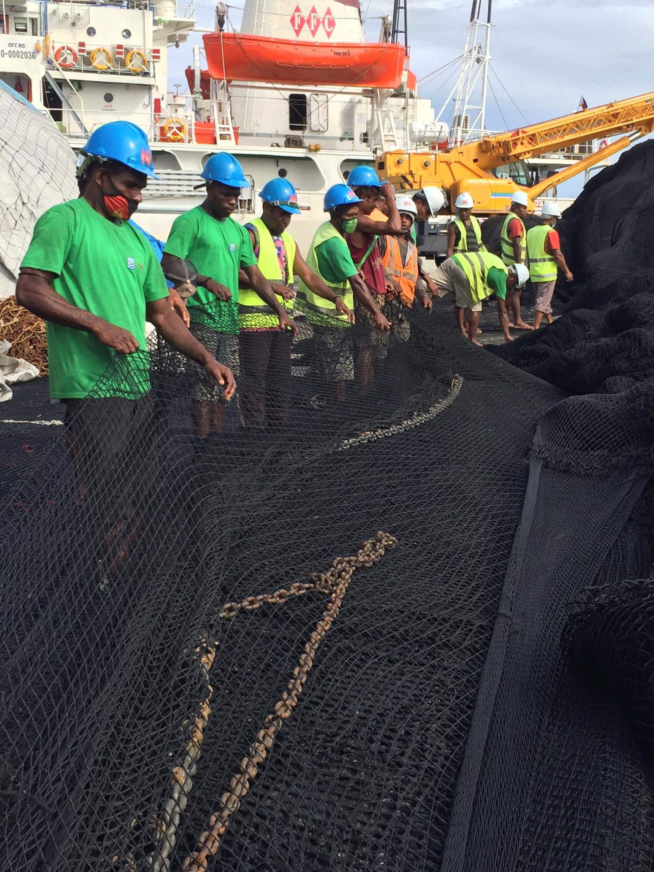
FIA-PNG Responsible Sourcing Policy (RSP) – value towards sustainability
RSP Commitment in 2017 and launched June 2018
FIA RSP – 1. Marine Steward Council Certification
FIA RSP – 2. Social Responsibility and Human Rights onboard
FIA RSP – 3. Marine Litter & Fishing Gear
FIA RSP – 4. Monitoring, Tracking & Traceability
Certification
May 2020
Marine Steward Council certification
Social Responsibility & Human rights onboard
Assessment &
Implementation
November 2019
Marine litter & Fishing Gear Management
Assessment &
Implementation
May 2019
Monitoring,
Track & trace
Since 2010
Monitoring, Tracking and Traceability
Assurance model development based on IFIMS + KPI = almost in real time

Slide 8
Domestic Fishery Background
In late 1960’s, initial baitfish and tuna surveys indicated stocks capable of sustaining commercial exploitation
PNG’s domestic commercial tuna fishery began since 1970 with the pole-and-line fishing
Ample supplies of bait-fish suitable for pole-and-line fishing
By 1972 four companies operated
By 1979, only 2 companies remained: Star-Kist PNG Pty Ltd and New Britain Fishing Industries Pty Ltd (NBFI)
Due to deteriorating world tuna market conditions NBFI terminated its operation in 1982
Likewise, Star-Kist terminated its operation in early 1983
Fishing operations were based in Kavieng and East New Britain Province due to proximity to good quality bait and tuna fishing areas
Attempts to establish shore bases, such as cold storage and cannery was unsuccessful
From 1970 to 1981, anchored motherships were used as cold storage closed to the bait fishing ground
Since 1970, catches were transferred directly from mothership to carrier and exported without being landed within the country
From 1971 to 1979, PNG ranked 3rd as a world producer of skipjack tuna (FAO 1972-80)

Slide 9
Bait and tuna fishing area

Slide 10
PNG’s pole-and-line Domestic Tuna Industry, 1979-81
Local Employment | Catch (mostly skipjack) | Number of Vessels | Exports (US$) | Exports (PGK) | Market destination
1,272 | 28,357 mt | 41 | $28.2m | PGK100m | USA (Mostly)
 |  |  |  |  | Japan (partly)
Source: Fisheries Division, PNG Department of Primary Industry, Port Moresby, Star-Kist (PNG) Pty Ltd and New Britain Fishing Industries Pty Ltd
Source: BPNG, Quarterly economic review, POM and U.S Dept of Commerce, Washington D.C

Slide 11
Fast-forward: Fishing Industry Operation (purse seine fishery)
Year | PNG flag | LBFV | Total
2018 | 26 | 35 | 61
2019 | 17 | 27 | 44
2020 | 12 | 32 | 44
2021 | 12 | 30 | 42

Slide 12
Future Outlook for PNG Flag Vessels
More PNG flag vessels are reflagging to other PNA Countries, especially Nauru and FSM
Since 2019, a total of 37 vessels reflagged to Nauru (9) and FSM (28)
These two countries offer discount on VDS fees and facilitate access of vessels into Eastern High Seas Pocket
By end of 2021, there were only 12 PNG flag vessels and 30 LBFV remaining

Slide 13
PNA Parties Vessel Days Scheme (VDS) Fees for Domestic and Foreign Fishing Vessels
Parties | Domestic ($)/Day | Foreign ($)/Day
Federated States of Micronesia | 6,000.00 | 11,000.00
Nauru | 6,000.00 | 9,600.00
Kiribati | 7,500.00 | 11,000.00
Marshall Islands (Republic of) | 7,500.00 | 10,000.00
Palau | 7,500.00 | 10,000.00
Solomon Islands | 6,000.00 | 10,000.00
Tokelau | 7,500.00 | 10,000.00
Tuvalu | 7,500.00 | 10,500.00
Papua New Guinea | 10,500.00 | 10,500.00

Slide 14
Implications of loss of PNG Flag Vessels
NFA will NOT sell all its fishing days
Inability to sell days will affect direct Government revenue
Fish caught by these vessels will not necessarily be processed in PNG but sold elsewhere, for instance in Philippines and Thailand, etc.
PNG will lose export earnings and contribution to GDP
Lose of local business spin-offs
Inability for NFA to pay rebates on catches offloaded in PNG for processing
NO Foreign Direct Investment will come to invest in PNG without competitive (cheap) Licences (VDS)

Slide 15
PNG Catch figures for Domestic Industry 2021
 | Catch (mt)
Domestic LBFV/PNG flag | 192,257
DWFN (take away) | 287,090
Total Catch | 479,347
Processed in PNG (PNG catch) | 97,814 (51%)
Transhipped | 94,443 (49%)
Processed in PNG (Catch from other waters/fishing companies) | 41,076
CPUE of 27 mt days fished in other PNA waters
PNG banned Locally-based foreign vessels (LBFV) from fishing under FSMA
As a result – loss of revenue of US$16 million (PGK58 million)
Therefore, NFA must immediately allow LBFV to fish FSMA and PNG flag to have access to Eastern High-seas Pocket

Slide 16
PNG Tuna Processing Industry
Year Established | Name of Processor | Full Capacity MT/Day | Current Capacity MT/Day | No of Processing Day/Year
1998 | RD Processing Ltd, Madang | 150 | 150 | 264
2006 | Frabelle PNG, Lae | 120 | 110 | 220
2013 | IFC Ltd, Lae | 120 | 45 | 140
2013 | Majestic Seafood, Lae | 250 | 110 | 213
2013 | Nambawan Seafood, Lae | 180 | 81 | 215
2013 | South Seas Tuna Corp, Wewak | 180 | 150 | 240
 | Total | 1,000 | 646 | 1,292
TOTAL EMPLOYMENT CURRENT 9,720 INDIRECT 48,600
FULL CAPACITY 15,000 INDIRECT 75,000
Current Processing Capacity 65%
For every direct employment 5 individuals are indirectly benefiting

Slide 17
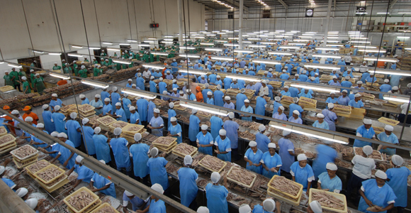
PNG Tuna Processing Industry
Based on the expected full capacity of the six (6) processing plants, PNG is already processing at 65% from catch by PNG flag and locally-based foreign vessels

Slide 18
EU Competent Authority and IUU Regulation
NFA was recognised by EU as a Competent Authority in 2002. Main function is to ensure quality of fish produced in PNG is in compliance with EU Foods Standard.
EU IUU Regulation came into force on 1 January 2010
NFA established Catch Documentation Scheme Unit in 2013
Yellow card was issued by EU to PNG in July 2014
Yellow card was lifted on 1 October 2015, and EU subsequently issued Green Card to PNG

Slide 19
PNA Scenario – 2018
PNA Countries | Catch (mt) | Value (US$)
Federated States of Micronesia | 229,000 | 421,000,000
Kiribati | 400,000 | 702,000,000
Marshall Islands | 53,000 | 111,000,000
Nauru | 125,000 | 208,000,000
Palau | 12,000 | 58,000,000
Papua New Guinea | 368,000 | 675,000,000
Solomon Islands | 142,000 | 306,000,000
Tokelau | 27,000 | 51,000,000
Tuvalu | 90,000 | 165,000,000
TOTAL | 1,446,000 | $2,697,000,000
Value Adding:
Total Catch = 53,555 containers
Number of Cases: 96,399,000
Value: @$60/case = $6 billion | (PGK20 billion)
Equates to 100,000 Direct Jobs
500,000 indirect Jobs

Slide 20
PNG Case
Without Value Adding:
Papua New Guinea | 368,000 mt | $675 million | PGK2.3 Billion
Value Adding - leveraging:
Total Catch | No. of Containers | No. of Cases | Value (US$) | Value (PGK)
368,000 mt | 13,630 | 24,534,000 | $1.5 Billion | K5.1 Billion
Equates to 25,000 Direct Jobs
(125,000 in-direct job)
VDS Revenue
US$187 million (PGK634 million) – Archipelagic Waters and EEZ

Slide 21
Facts
Conservation and management of fisheries resources in PNG is well managed;
Strong compliance, monitoring and enforcement regime in place and effectively working;
Quality assurance maintained with audit and certification, a protocol of the EU is accredited with a competent authority status maintained since 2000;
EU IUU Regulation requirement with establishment of the CDS or Catch Documentation Scheme in 2013 and consistently maintained to date;
This facilitates trade and market access of PNG fisheries products to EU market duty free, quota free;
IEPA (interim economic partnership agreement) with EU allows its fisheries products to be globally sourced, processed into can or loin qualifies duty free quota free access to EU markets
Since 2014, no new investments in PNG after RD in 1998, SSTC in 2002, Frabelle in 2006, IFC/Majestic and Nambawan in 2013

Slide 22
Fisheries Management Plan – Local Content & Local Participants
National Tuna Fishery Management Plan 2014
- K5 billion Industry – still open to foreign participations
Gulf of Papua Prawn Fishery Management Plan
- K28 million Industry – fully domesticated industry with around 400 employees
Orangerie Bay Prawn Fishery Management Plan
- Fully domesticated but small industry
National Lobster Fishery Management Plan
- K21 million Industry – fully domesticated industry with around 500 employees
The Shark Fishery Management Plan – fully domesticated industry
National Beche-De-Mer Fishery Management Plan
- K130 million Industry – fully domesticated with around 500,000 people involved
The National Mud-crab Management Plan – fully domesticated industry
The FAD Management Plan – a well regulated & managed plan
Trial Fishing Policy 2001 – fully domesticated industry and well regulated
Life Reef Fish Trade – fully domesticated industry
Barramundi Management Plan – fully domesticated but small industry

Slide 23
FIA-PNG Partnership & Stakeholders
Notes:
With an access to real time – iFIMS is a tablet-based application was developed to allow vessels to e-report catch and other information such as vessel position, notices, and observer requests. Data can be lodged to fisheries authorities direct from the iFIMS portal.
Observer module allows communication between onboard observers and their onshore observer programs, supporting both observer safety and observer program integrity.
VDS module provides Agencies the VDS data displayed in FIMS is accurate – as long as the vessel is reporting its position and catch data accurately of course! E-reporting / e – observer rep[orting

Slide 24
Take-home Message: Catch and Stock Status by Ocean

Slide 25
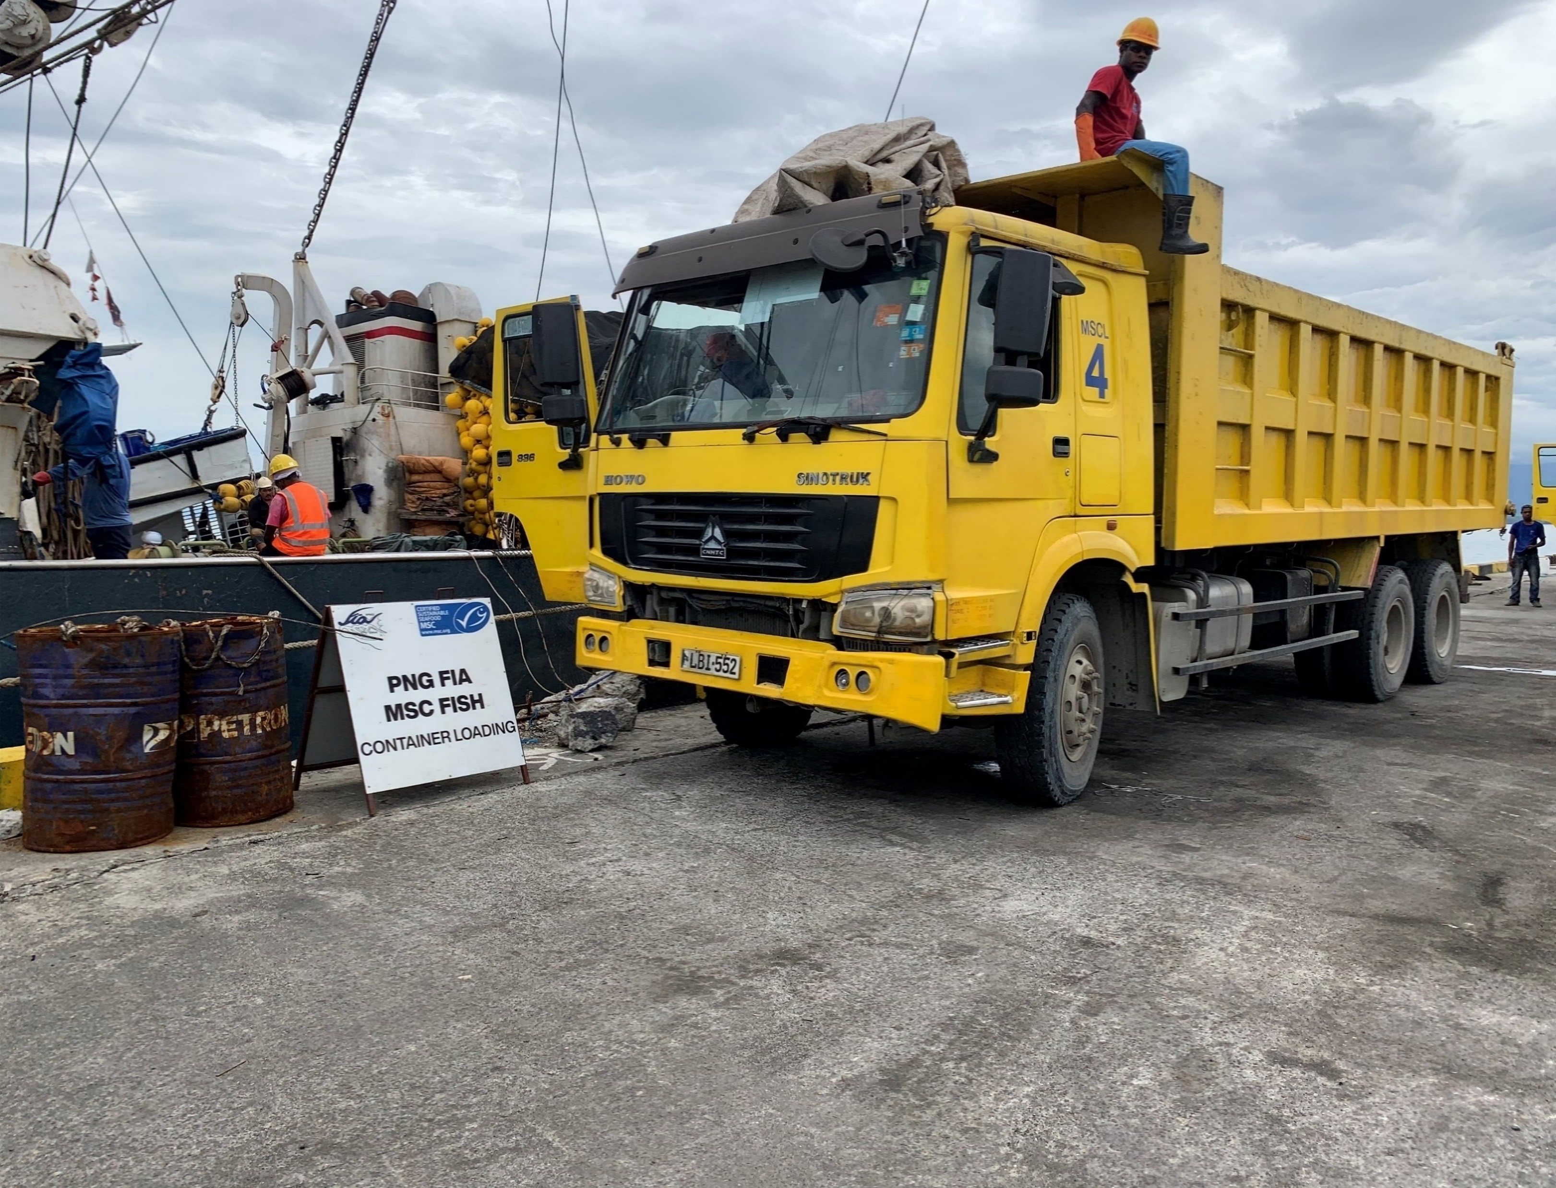
Thank you!
Contact email: spokajam2@gmail.com
Source: FIA PNG office

