Slide 1
PNG TUNA DOWNSTREAM PROCESSING: BUSINESS CHALLENGES
NAP BENITEZ
GM
MAJESTIC SEAFOOD CORP LTD

Slide 2
2020 ESTIMATE
INDUSTRY INFO C/O FIA
Processor | Description | Current Capacity mt/day | Full Capacity mt/day | Current Workers | Est. Payroll | Location
RD Canners LTD | Tuna Canning/ Loining | 140 | 150 | 3,532 | 32,141,200 | Madang
Frabelle PNG Ltd | Tuna Canning | 120 | 140 | 1,860 | 16,926,000 | Lae
IFC Ltd | Tuna/Mackerel Canning | 45 | 120 | 1,022 | 9,300,200 | Lae
Majestic Seafoods | Tuna Canning | 100 | 250 | 1,400 | 12,740,000 | Lae
Nambawan Seafoods | Tuna Canning | 65 | 75 | 1,000 | 9,100,000 | Lae
South Seas Tuna Co | Tuna Loining | 150 | 200 | 2,260 | 20,566,000 | Wewak
 | TOTAL | 620 | 935 | 11,074 | 100,773,400
GST – 10% (K10m)
NPF – 08% (K8.5m)

Slide 3
Catch Landed & Processed by PNG Flag & LBFV – year 2020 data
INDUSTRY INFO C/O FIA
Table 1
Total Catch (mt) | Value ($1,000/mt) | Value (PGK @ 0.2925)
304,624 | $304,624,000 | K1,041 billion
Table 2
Total Domestic Catch – PNG Flag & LBFV (mt) | Total Domestic Catch Value ($1,000/mt) | Total Domestic Catch Value (PGK @ 0.2925)
198,806 | $198,806,000 | K680 million
Table 3
Catch Landed for Processing (mt) | Value ($2,000/mt) | Processed Value (PGK @ 0.2925)
117,710 | $235,420,000 | K804.855 million

Slide 4
Landed, Unprocessed & Exported by PNG Flag and LBFV – year 2020 data
INDUSTRY INFO C/O FIA
Unprocessed Catch & Exported as Whole Round Tuna (mt) | Unprocessed Value ($1,000/mt) | Unprocessed Value (PGK @ 0.2925)
81,096 mt | $81.096 million | K277.251 million
Table 4
Domestic Value Adding & Unprocessed Domestic Exports – year 2020 data
Processed Value – Table 3 (PGK) | Add: Unprocessed Value (PGK) – Table 4 | Total Value
K804.855 million | K277.251 million | K1.082 billion
Table 5

Slide 5
Value of Direct Export Without Processing - year 2020 data
INDUSTRY INFO C/O FIA
Total Domestic Export Value adding & Unprocessed Value – Table 5 - (PGK) | Less: Total Domestic Catch Value – Table 2 (PGK) | Impact of Downstream Processing & Domestic Export (PGK)
K1.082 billion | K680 million | K402 million
DIRECT REVENUE FROM VESSEL DAYS SCHEME – K450 million (US$133 million)
Contributions of Fisheries to GDP – 3%

Slide 6
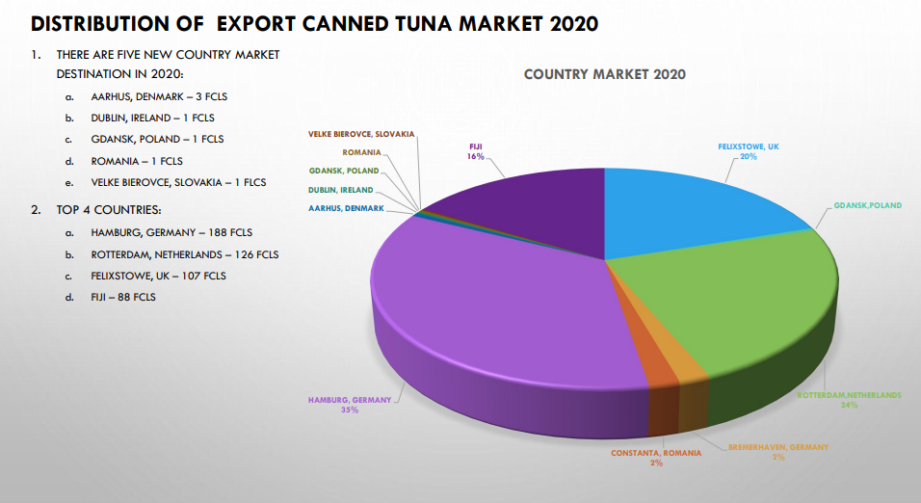
COMPANY SPECIFIC INFO

Slide 7
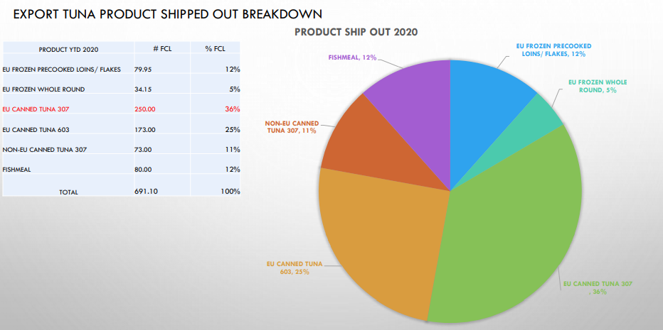
COMPANY SPECIFIC INFO

Slide 8
BUSINESS CHALLENGES: FREIGHT COST AND OTHER ISSUES
Increase in Freight not reflected in bid offer by buyers
Other Freight Issues:
Lack of Containers/Reefers: Maersk has consider 100 20 ft dry and 90 Reefers in 2022. No guarantee after this quantity.
Congestion in Malaysia Feeder Port cause delay and non accommodation of shipments. e.g Feb 28 Maersk ETD has move to Mar 5
3. Other shipping cannot guarantee dry or reefer units and if available like Swire their freight cost is 2-3X higher

Slide 9
BUSINESS CHALLENGES: OFFER/BIDS OF BUYER DO NOT MATCH CURRENT FISH PRICE
Frozens loins particularlyYF 3.5-9.99 (TriMarine and Generale) have better profit margin @ $ 380/MT
Being selective on getting Canned Tuna contract will lead under capacity, $4.99/case loss is comparable to shutdown cost of the plant @ 85 MT.
Market Feedback of processors in PNG accepting price offer indicated by MEM and feedback from Frinsa

Slide 10
BUSINESS CHALLENGES: COST AND MARGIN PRESSURES
PNG REBATE POLICY: POTENTIALLY REDUCE TO $250 BY JUNE 2022 AND ELIMINATION BY 2023
PNG COST OF FUEL AND UTILITIES: DIESEL PRICE HAS INCREASED BY 23% (K 3.124 IN FEB 8 FROM AVERAGE LAST YEAR OF K2.53) EXPECTED TO GO HIGHER MARCH-MAY DUE TO CRUDE OIL PRICE HIKE.
IRC GST REFUND: EXTENDED DELAY IN GST REFUND FOR OVER 12 MONTH
PNG CUSTOM REVIEW ON CORRUGATED CARTONS IMPORTS: CHARGING 10% DUTIES EVEN THOUGH THE CARTONS ARE 100% USE FOR EXPORT. 90% OF PACKAGING IS IMPORTED

Slide 11
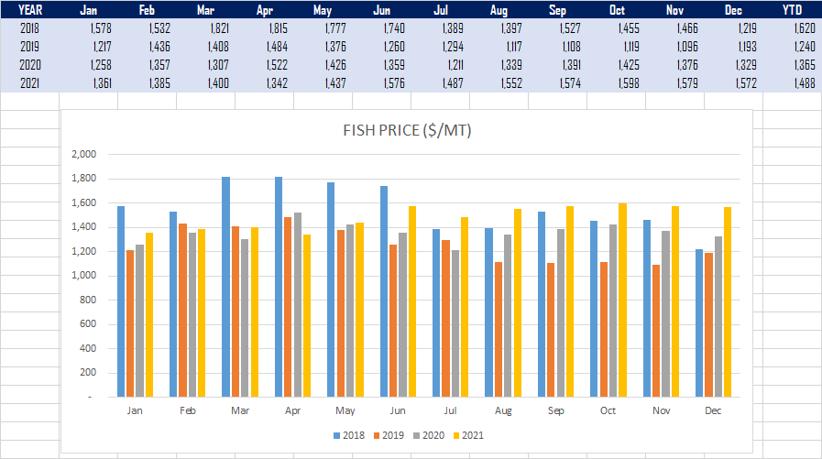
BUSINESS CHALLENGES: FISH SUPPLY AND PRICE
Fish Price Jan 2022= $1600
FISH CATCH PRODUCTIVITY HAS BEEN DISMAL FOR THE LAST 6 MONTHS. MAJESTIC VESSEL MALVIENNE AND KAMILLAH HAS ON AVERAGE 14 MT CATCH AVERAGE PER DAY. E.G. MALVIENNE IN 4 WEEK FISHING ONLY HAD 335 MT TO SHOW (JAN 10-FEB 17)

Slide 12
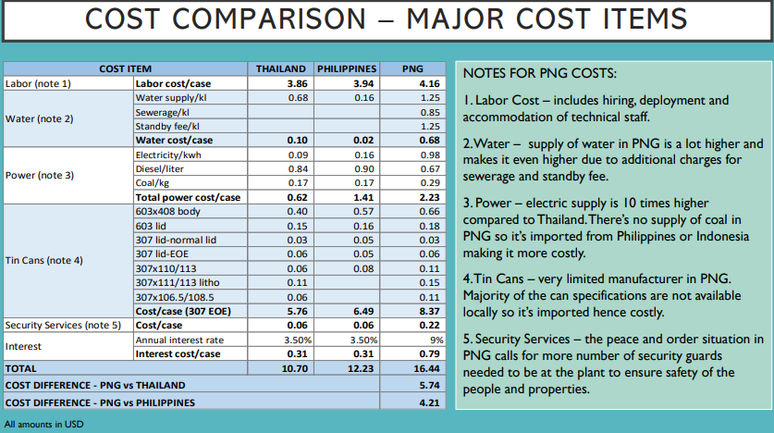
CHALLENGES IN DOING BUSINESS IN PNG

Slide 13
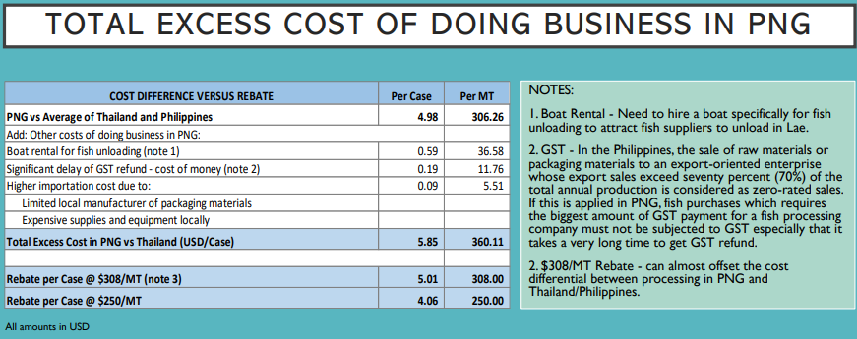
CHALLENGES IN DOING BUSINESS IN PNG

Slide 14
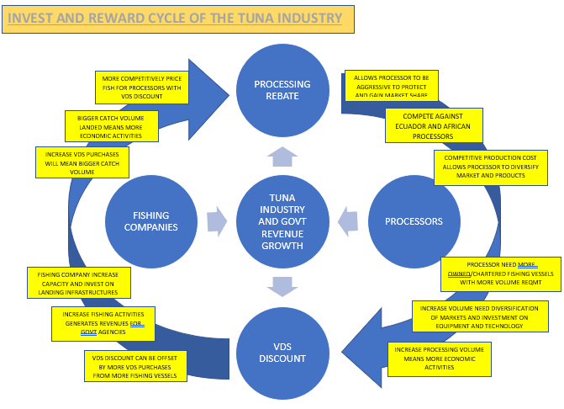

Slide 15
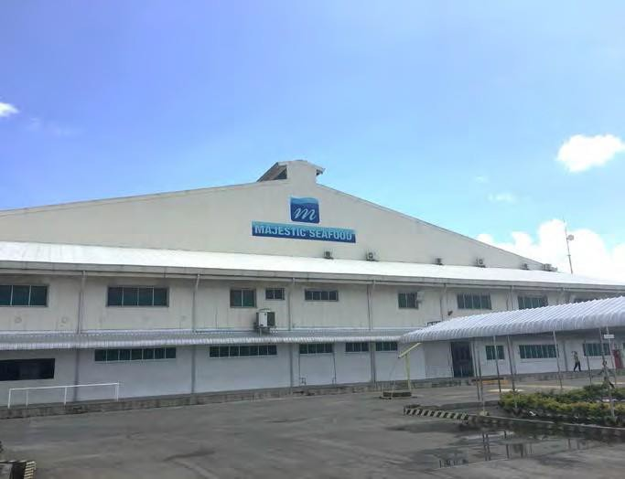
THANK YOU
FRABELLE
GROUP
CENTURY PACIFIC GROUP

