Slide 1
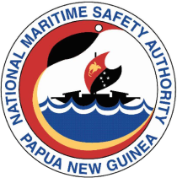

Welcome to the
NATIONAL MARITIME SAFETY AUTHORITY
Promoting Safety First At Sea
| W: www.nmsa.gov.pg

Slide 2
NMSA STANDARDS & REQUIREMENTS FOR A SAFER FISHING INDUSTRY
National Tuna Industry Consultations 23-24 February 2022
Promoting Safety First At Sea
| W: www.nmsa.gov.pg

Slide 3
Topics of the Presentation
What is NMSA
NMSA Structure
NMSA Core Functions
Ship Registry – Vessels Statistic
NMSA Standards & Requirements for a Safer Fishing Industry
NMSA input into a Safer Fishing Industry
Some of NMSA latest Achievements
Summary

Slide 4

WHAT is NMSA?
The National Maritime Safety Authority, was established by an Act of the Parliament in 2003, as a Not- For- Profit Public Body on a self sustaining basis and reporting to the Board and the Minister for Transport. It actually commenced its operation on 01 January 2006.
The Authority’s mandate includes the NMSA Act, the Merchant Shipping Act, Oil Pollution Levy Act and the Maritime International Conventions that the Independent State of PNG is a party to. Thus the Authority’s mandate is:
1. Maritime Safety Standards;
2. Marine Pollution Prevention and Coordination of Clean Up; and 3. Co-ordination of Maritime Search and Rescue
Promoting Safety First At Sea
| W: www.nmsa.gov.pg

Slide 5
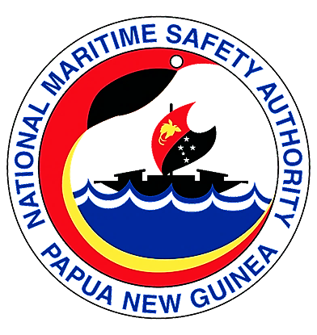
NMSA Structure
NMSA Board
Legal Services
Internal Audit
Project Management Unit
Public Relations
GM/CEO
Maritime Operations Division
Maritime Administration Division
Corporate Services Division
Executive Manager (EMMO)
Executive Manager (EMMA)
Executive Manager (EMCS)
Ships Surveys & Inspection
Navigation Safety Services
Hydrography
Marine Environment Protection
Safety Search & Rescue including Small Craft
Maritime Domain Awareness
Maritime Standards
Qualifications & Crewing
Pilotage Administration
Ships Registry
Community Development
Finance & Administration
Corporate Strategy & Quality Assurance
Information Communication Technology
Human Resources
www.nmsa.gov.pg

Slide 6
NMSA Core Functions
Registration of ships
Registration of sea-farers
Quality Control of seafarers qualification
Monitoring navigational aids through maintenance programmes
Establishing and refurbishment navigational aids
Ensuring search and rescue operations are instigated whenever required
Promoting Safety First At Sea
| W: www.nmsa.gov.pg

Slide 7
NMSA Core Functions cont.
Monitoring safety of ships through Flag State Control ( Domestic Vessels) and Port State Control Inspections ( Foreign Vessels)
Maintaining, updating and supplying the PNG chart profolio and nautical publications
Ensuring environmental marine pollution responses whenever needed
Investigation all maritime incidents, accidents and causalities
Prosecuting infringements of PNG laws
Enforcing wreck removal
Promoting Safety First At Sea
| W: www.nmsa.gov.pg

Slide 8
PNG Ships Registry: Vessel Statistics
Vessel Type | Total
Fishing Vessels | 122
Tug Boats | 153
Dumb Barges | 123
LCTs | 76
Passenger Vessels | 45
General Cargo/Container | 86
Work Boats | 45
Others | 93
 | 743
www.nmsa.gov.pg

Slide 9
NMSA STANDARDS & REQUIREMENTS FOR A SAFER FISHING INDUSTRY
The fishing vessels and the fishing industry is among the most dangerous jobs/ industries in the world.
There are no separate legislation for Fishing Vessels in PNG and also they are not exempted from our registration.
Fishing Vessels like any other vessels come under Merchant Shipping Acts of 1975 and Safety Regulations of 2006 to ensure seaworthiness of the vessels.
The FVs registered with NMSA are issued with Certificate of Registration, Minimum Safe Manning Certificate and Survey/Safety Certificates. The NMSA inspectors conduct inspection on FVs to ascertain the validity dates of the survey certificate, the manning of the vessel in accordance to its Minimum Safe Manning Certificate, and compliance to various safety requirements.

Slide 10
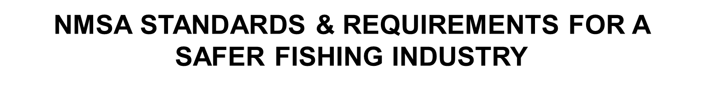
The vessel is issued deficiency notice if it is non-compliance to the safety regulations and for critical or serious defect the vessel can be detained.
To maintain the safety standard the FVs are surveyed annually by the NMSA non-exclusive surveyors and the survey report submitted to NMSA office for the review of the report. If the report is in good order the survey certificate is endorsed or a new full term survey certificate is issued for a period of 4 years.
For Foreign Fishing Vessels the NMSA inspectors conduct Port State Control inspection in line with Tokyo MOU procedure.

Slide 11
NMSA ensures Standards of Training, Certification and Watch keeping (STCW) as per the IMO STCW Convention are maintained in institutions doing training for seafarers on fishing vessels.
Although the STCW Convention does not cover certification of fishing vessels nor is there much mention of fishing vessels in the current MS Act 1975. All vessels inclusive of fishing vessels registered under the act come under the provisions of the act, which includes safe manning of the vessel.
For foreign flagged fishing vessels, NMSA ensures Masters, Officers, Engineers and crew have the qualifications and experience to serve on these vessels to ensure safety of navigation and fishing operations at sea.

Slide 12
Where certificates of recognition (COR) is applied for to work on PNG Flagged fishing vessels and/or an application for a Work Permit Clearance Letter is received, NMSA verifies certificates through the issuing administration before these the COR /WPCL is issued. The verification time depends on the issuing administration and the accessibility.
Note that previously the fishing industry sent applications for CORs and WPCLs to NMSA to verify and issue these documents. For reasons not mentioned the fishing industry has now bypassed this process and gone straight to NFA and the DLIR (Work Permits) to get work permits and engage foreign nationals without CORs to work on PNG Flagged Fishing Vessels. This is a dangerous trend and increases the risks and safety of the fishing vessels and other crew on board, not to mention Terrorism, Money Laundering and other illegal activities by these Fishing Vessel personnel with unverified identities.

Slide 13
For the PNG near coastal fishing industry, since the early 2000s NMSA has worked closely with the National Fisheries College (NFC). PNG is yet to ratify the STCW-F 95 convention for certification of fishing vessel crew therefore currently all training and certification is guided by the STCW convention, the Pacific Community (Formerly SPC) training modules and our domestic legislations.
NMSA encourages the Fishing Industry to support the NFA through the National Fisheries Collage, to secure jobs for the Fisheries College graduates on the Fishing Fleet operating in our EEZ and under license in other Pacific countries. This creates jobs for our nationals as well as train them for careers in the Fishing Industry.

Slide 14
Under the reviewed 2021 Fisheries Training Package, NMSA worked closely together with the NFC to align training and certification of domestic fishing vessel masters, officers and engineers to the merchant shipping career pathways. This ensures that the training conducted at the National Fisheries College which is a NMSA recognized maritime training provider, is on par with seafarer training conducted for fishing vessel crew in similar institutions around the world.
Aligning the fishing vessel certification with the merchant career pathways enables fishing vessel personnel to do courses higher than the level of certification offered at NFC. Currently Commercial Fishing Operations 3 (CFO3) is the highest certification level offered at NFC. This is equivalent to Master/ Mate Class 5 and Engineer Class 5.

Slide 15
The National Fisheries College and the NMSA are optimistic that higher levels of training to be in command of large purse seiners, trawlers and other fishing vessels will be offered at NFC instead of following the merchant ships career pathways in the not too distant future. This higher levels of training will include Nautical, Engineering, Fishing Gear Technology, Techniques and Operations. This will go a long way to supporting and making the fishing industry safer.
The current certificates issued for seagoing personnel for domestic fishing vessels are;
1. CFO1 – Fishing Deckhand
2. CFO2 – Coastal Mate/ Master
3. CFO2 – Assistant Engine Driver
4. CFO3 – Offshore Mate/ Master
5. CFO3 – Engine Driver

Slide 16
NMSA INPUT INTO A SAFER FISHING INDUSTRY
NMSA Standards for Training Certification and Watch Keeping on Fishing Vessels.
NMSA Legal Obligations on Safety and Manning of the Fishing Vessels.
Issuing of Certificates of Recognition (COR) and Work Permit Clearance Letters (WPCL) for Foreign Fishing Vessel Masters, Officers, Engineers and Deckhand Fisherman.
Monitoring Training of Seafarers for fishing vessels conducted by Fisheries College in Kavieng. NMSA conducts regular audits of the College and issues 3 yearly approval to conduct Maritime Training for fishing vessel Masters, Officers, Engineers and Crew.
Certification of Masters, Officers, Engineers and Fishing Vessel Crew

Slide 17
NMSA INPUT INTO A SAFER FISHING INDUSTRY
Inspecting Domestic Fishing Vessels (Flag State Inspection) and Foreign Fishing Vessels (Port State Control).
Survey of the Fishing Vessels conducted by NMSA Non-exclusive Surveyors to ensure seaworthiness of the vessels.
NMSA Marine Casualty Investigation team engaged in investigating various incidents on Fishing Vessels (grounding, sinking, MOB, fire o/b, etc.)
Registry of all Fishing ships under PNG Flag

Slide 18
NMSA INPUT INTO A SAFER FISHING INDUSTRY
NMSA Maritime Rescue Coordination Centre provides 24/7 support to all Fishing Vessels in distress
Search And Rescue Information Management System (SARIMS) provides safety to all fishing vessels operating in PNG waters
NMSA Navigational Safety Services department maintains over 300 Aids to Navigation in PNG for the safety of navigation.
Vessel Monitoring System and Coastal Monitoring Stations operated by Maritime Domain Awareness department monitors PNG waters for safety of navigation and identification of all kinds of illegal activities including illegal fishing.

Slide 19
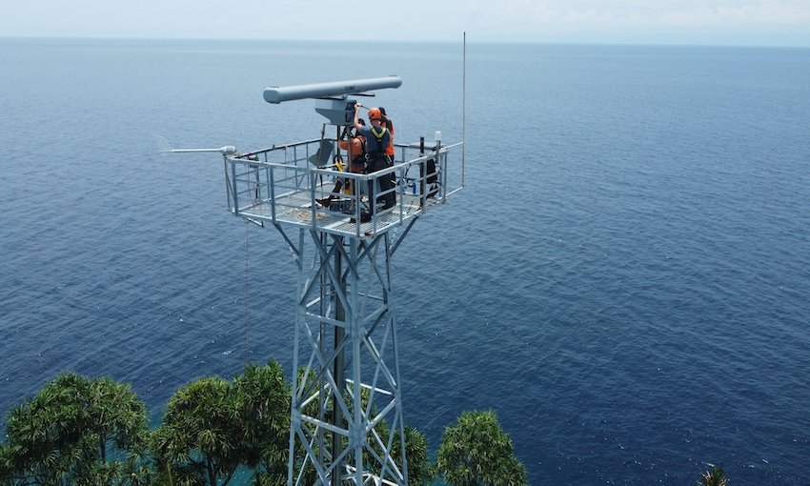
CMS - Coastal Monitoring Stations installed in Tuam and Jomard
Some of NMSA Achievements
VMS - Vessel Monitoring System from VISSIM in Norway.

Slide 20
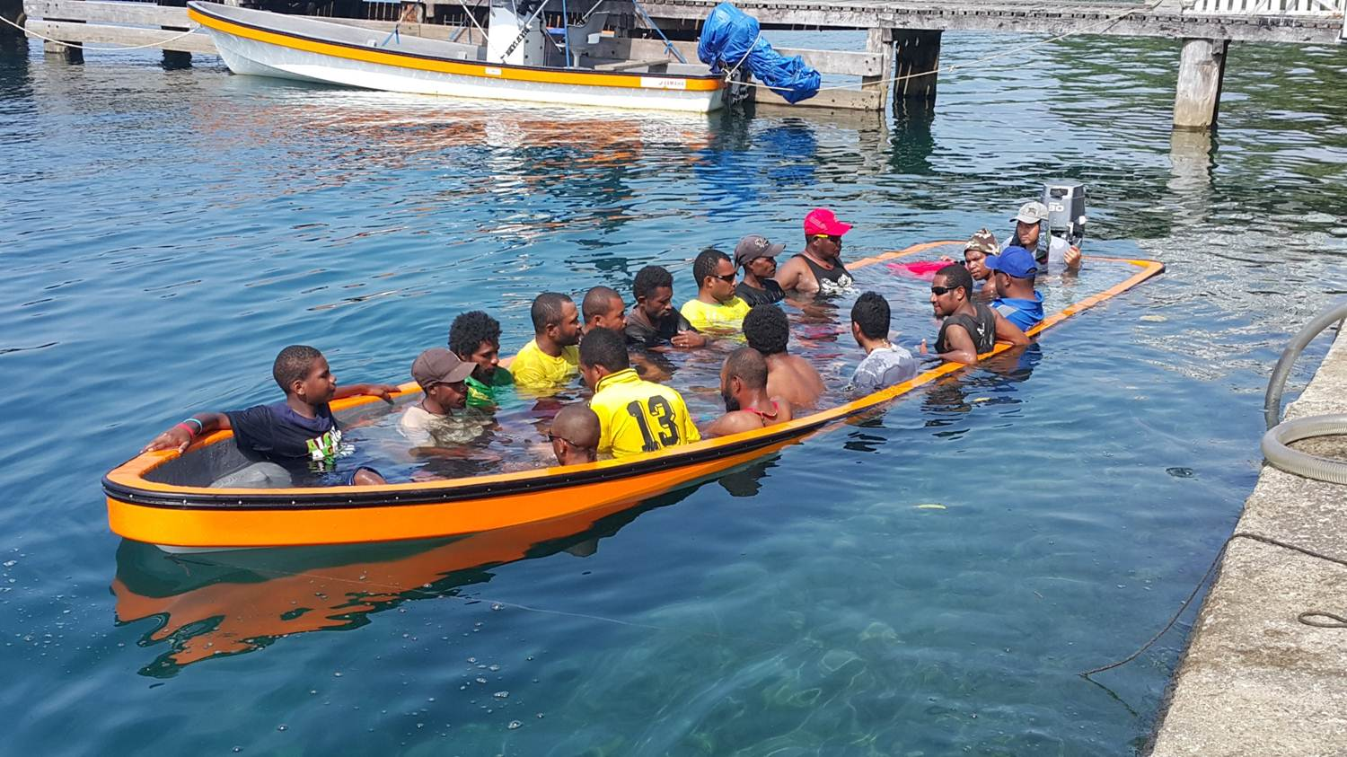
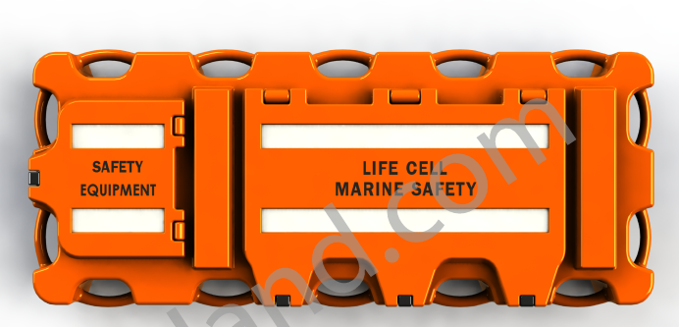
SARIMS (Search & Rescue Information Management System) from Critical Software in Portugal
New type of dinghy with added buoyancy to prevent sinking.
Life Cell - life saving devices sponsored by TSSP

Slide 21
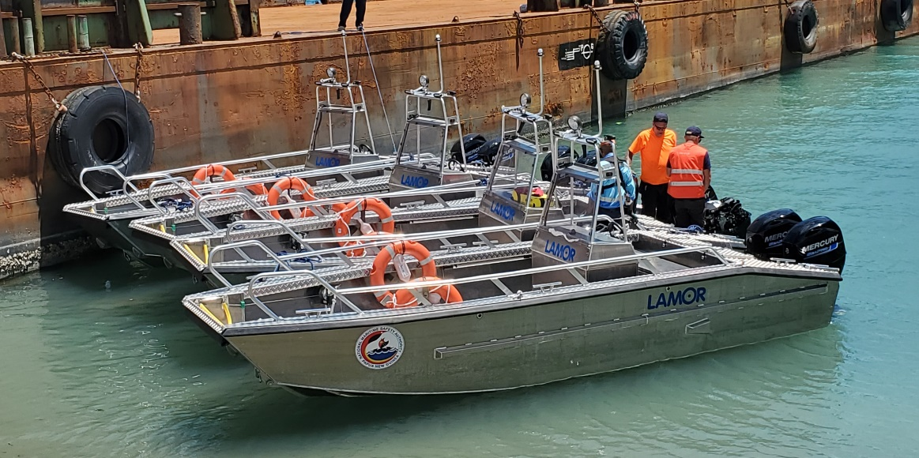
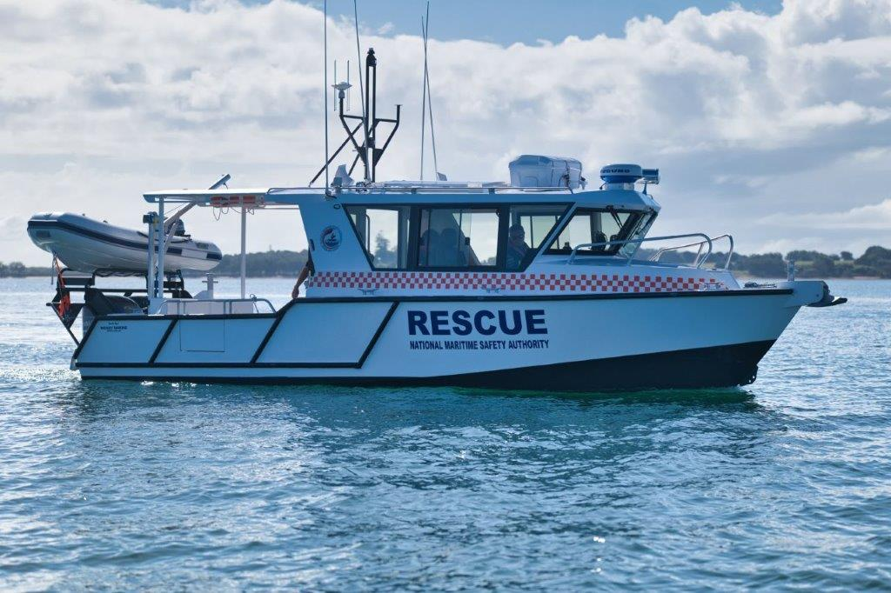
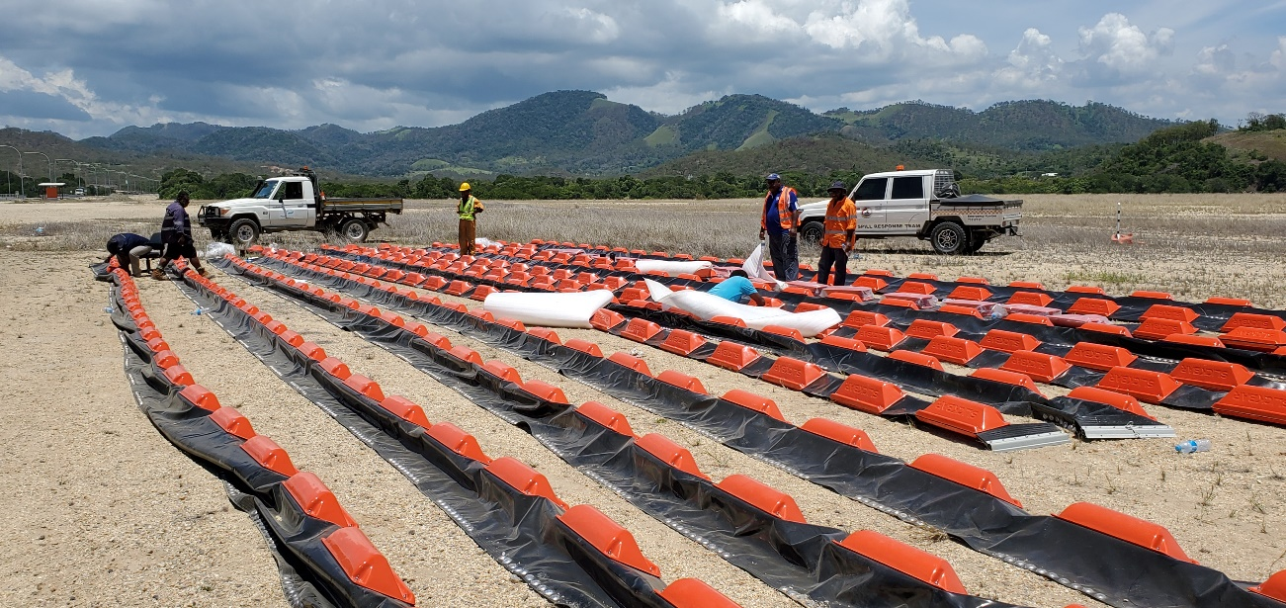
Oil Spill Response Equipment from Lamor in Finland
Search and Rescue Vessels (2 already in operation, another 5 including 3 x 20m sponsored by Japan expected within the next 2 years)

Slide 22
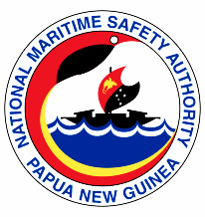
Summary
The Papua New Guinea National Maritime Safety Authority, as the Maritime Regulator is continuously evolving and innovating to keep relevant services, policies and practices updated and in par with acceptable World Standards.
MOU between NMSA and National Fisheries Authority will straighten capabilities of both agencies for a safer fishing industry.
www.nmsa.gov.pg

Slide 23
THANK YOU!
Promoting Safety First At Sea
| W: www.nmsa.gov.pg

