Slide 1
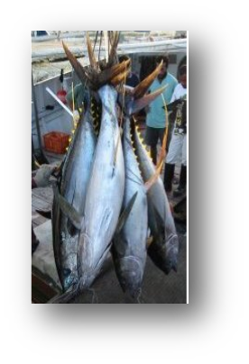
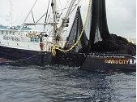
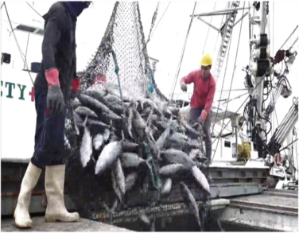
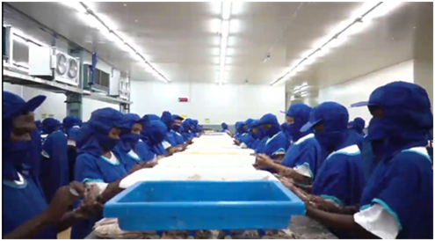
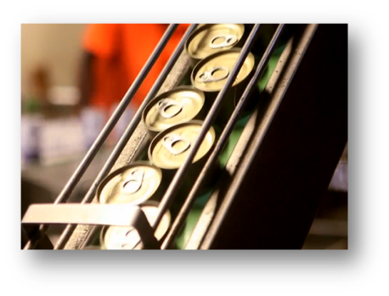
Topic: Status of Tuna Industry Development in PNG
Tuna Industry Consultation
Meeting
Date: 23-24th February 2022
Hilton Hotel
Hilton Hotel

Slide 2
Outline of Presentation
General overview of the tuna industry.
Ia. 2017 Tuna Industry Consultation Outcomes
ib. Industry overview
ii. Current state of play by tuna fishery
iii. Economic outlook
IV. Markets- a) domestic market
d) export market
IV. Industry concerns
V. Enabling Infrastructure
V. Conclusion:

Slide 3
2017 Tuna Industry Consultation Outcomes
Outcomes are prepared and provided in the information booklet for clients to read and participate in the meeting

Slide 4
General Overview of the Tuna Industry
Tuna Purse Seine Fishing- Bilateral/Multilateral access-generate resource rents through VDS -
Domestic flagged and locally based foreign vessels supply fish to the onshore processing facilities i.e. canneries or loining plants.
High relative unit cost of production compared to producers in the South East Asia. Rebate scheme has been introduced to stabilize cost of production, but it will be revised with a view to reduce rebate and look at other mechanisms to reduce unit cost of production. For example, dedicated fisheries wharves, reliable power and water supply, more preferential market access, and dedicated labor force, and supportive other govt’l regulatory bodies
Tuna Longline: Domestic tuna LL ceased except one operator and is now operating charter ULT vessels
Tuna Longline access operate mainly ultra low temperature vessels

Slide 5
ii. Current state of play by tuna fishery
Guided by Tuna Fishery Management Plan since 1999 and expanded in 2014 which incorporates sustainable management and development
There was amendment to the NTFMP that covered the introduction of the handline fishery which aimed at involving participation by PNG national, But none at the moment
The largest fishery in both catch quantity and economic terms primarily skipjack and yellowfin with smaller quantities of bigeye, albacore and other species
It is estimated that the resource can sustain annual catches of 300,000 to 600,000 metric tonnes with potential market value of US dollar 600 million (K1.8 billion current exch rate) depending on the commodity price
Domestic longline vessels and domestic, locally based foreign and foreign flagged purse seine vessels operate under various arrangements
Generates the bulk of revenue for NFA to cover its operations and fund sector initiatives

Slide 6
iii. Economic outlook
Employment, Export, capital formation, tax revenues, spinoff business opportunities

Slide 7
Economic Indicators
Indicator | 2017 | 2018 | 2019 | 2020 | 2021
Landings(MT) | 93,951 | 95,194 | 110,900 | 117,710 | 118,105
Production(MT) | 85,161 | 87,264 | 107,250 | 111,094 | 117,483
Exports volume (mt) | 135,064 | 146,548 | 208,701 | 220,349 | 198,894
Export values (US$’M) | 417 | 444 | 634 | 448 | 416
Employment (No of people) | 8,415 | 8,818 | 10,282 | 11,114 | 12,469
Capital formation (K’M) | - | - | - | - | -
Tax (K’M) | - | - | - | - | -
Source: NFA
Notes:
Ave prod/day 656 mt/day or 58% of design capacity (compared to 26% or 113 mt/day 2012 -2015)
Ave operational days 229 (compared to 117 days 2012 -2015)
Revenue collection excluding LL vessels
Average increases year-on-year – (landing 6%), (prodt 8%), (export 7%) & (employment 10%)

Slide 8
Exports by product type
Year | Canned (mt) | Loins & Flakes (mt) | WR tuna | Others (mt)* | Grand total (mt) | Amount (USD’million)
2017 | 34,644 | 15,326 | 85,093 | - | 135,064 | 417
2018 | 33,464 | 19,475 | 93,607 | - | 146,548 | 477
2019 | 40,100 | 19,061 | 163,961 | 8,235 | 231,158 | 634
2020 | 36,534 | 16,163 | 153,454 | 14,198 | 220,349 | 448
2021 | 39,220 | 47,259 | 101,590 | 10,825 | 198,894 | 416
Source: NFA

Slide 9
Markets
Domestic market- Tuna is being canned onshore factories for domestic market to meet consumer preferences
Export market: EU market and UK market
China market: Currently confirmed with companies including frozen,canned and chilled fish products have now been registered with General Administration of China Customs (GACC)
Australia market
Middle East market
Russia
Brazil
-

Slide 10
Industry Concerns
Lack of dedicated fisheries wharf in Lae to land catches for the 3 canneries apart from Frabelle wharf that is now being utilised given that planned Wagang wharf will take longer to be realised.
Power supply to SSTC factory in Wewak and suitable permanent landing wharf
Lack of domestic tuna supply for the IFC factory
Lack of swift support to the industry by other regulatory government agencies
Alternative market access

Slide 11
Enabling Infrastructure and Operating Environment
Planned projects;
Wagang wharf
Rabaul Tuna Terminal
N’Drauke
Madang Pacific Industrial Zone (PMIZ)

Slide 12
Conclusion:
To maximize returns to the country, timely and considerate intervention by Govt to build tailored infrastructure and support services to facilitate tuna developments is critically important

Slide 13
End of Presentation

