Slide 1
NATIONAL TUNA INDUSTRY CONSULTATION
HOLISTIC TUNA FISHERIES DEVELOPMENT. HOW DO WE DO IT?
23-24 February 2022
Hilton Hotel. Port Moresby
Brian Kumasi – Policy Manager (PNAO)
Notes:
Minister for Fisheries and Marine Resources and Parliamentary Member for the District of Wabag, Hon Dr Lino Tom,
Mr Ango Wangatau, Chairman of the National Fisheries Board,
Mr Koni Samuel, Secretary for the Department of National Planning and Implmentation
Mr Justin Ilakini, Acting Managing Director National Fisheries Authority and your staff,
Sylvester Pokajam, Chairman of the Fishing Industry Association and your association members,
Representatives of other regional agencies,
Members of the diplomatic corps
Ladies and gentlemen,
On behalf of the Chief Executive Officer of the Office of the Parties to the Nauru Agreement, Dr Sanga’alofa Clark, I extend her appreciation for the invitation for us to contribute to these important discussions over the next two days.
My name is Brian Kumasi and I have recently joined the PNAO as the Policy Manager. I will be making this presentation alongside Mr Thomas Usu, Acting Executive Manager Fisheries Management of NFA. We hope to make this presentation interesting and hopefully generate some discussion on the topic of sustainable fisheries management.

Slide 2
Sustainable Management of Tuna Fisheries in PNG. Focus on the Vessel Day Scheme
What is the value of sustainability?
What is the potential impact of compromising sustainability?
How can additional value be provided through the VDS?
Notes:
We were asked to prepare a presentation on the topic of sustainable management of tuna fisheries focusing on the VDS. Most of you in the room should be familiar with of have some understanding of the VDS. So I will only spend a couple of slides going through the workings of the VDS for those in the room that may not have the benefit of an understanding of the VDS.
In discussions with the organizers we thought it would be useful to also touch on a couple of specific areas”
What is the value of sustainability?
What is the potential impact of compromising sustainability?
How can additional value be provided through the VDS?

Slide 3








VDS as a Tool for Sustainability
Notes:
The VDS is a fisheries management tool that is made possible by the operation of a secure, satellite based, vessel monitoring system. Where ever a fishing boat that is licensed and registered to fish in PNG and the wider PNA region, that vessel is tracked from port-to-port, allowing the time spent in the waters of each country to be monitored and accounted for.
This led the way in 2008 for the introduction of the VDS by the PNA, which became operational in 2009. The PNA Parties looking to increase their participation in the tuna purse seine fishery moved away from limiting the amount of licenses in their combined fishery from 250 to a system that allowed the PNA Parties more advantageous terms to domesticate part of the fishery.
The VDS also had the additional benefit of dissociating the price of fisheries access from previous base of access agreements as tonnage of fish and the Bangkok / Pago Pago tuna price. This leverage of the opportunity to fish eliminated the incentives to under-report catches that formed the basis for access fees, high grading catches and discarding of low value species.
At a time when the wider WCPFC membership were looking at developing measures to curb the unintentional catch of juvenile bigeye and yellowfin tuna. This management regime shift in our assessment played a significant part in being able to negotiate measures that not only resulted in sharing the conservation burden equitably between fisheries and participants but the proof as they say, is in the pudding.

Slide 4
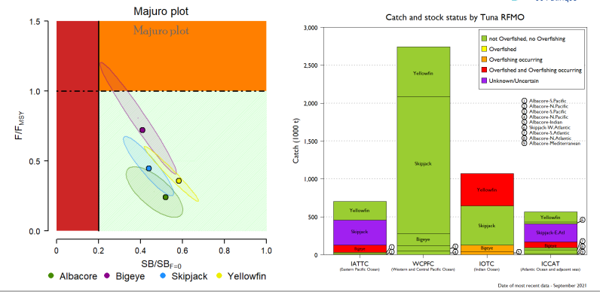
VDS as a Tool for Sustainability
Notes:
The figure on the left is a comparison of the four main tuna species that are caught by different regional fisheries management organizations. What this figure tells you is that the fishery in our region is by far the largest in terms of the amount of tuna that is caught, but also, that all the species that are being taken are being done so in a biologically sustainable manner. Further to that, the reference points being used by the WCPFC are more conservative than that of the other RFMOs so the situation in the other RFMOs is in worse shape than can be represented here.
The colours are traffic light indicators. These are based on the specific reference points used by each RFMO in their stock assessments. Green means the stocks are in good shape and no overfishing is occuring, yellow means the stocks are experiencing overfishing and red means the stock is in an overfished state.
The figure on the right gives you a simple representation of the state of the 4 main species caught in the WCPFC area using a common reference point to reflect their relative state to each other as a comparison.
The conclusion, the VDS is working as a fisheries management tool to keep the tuna fisheries at sustainable levels.

Slide 5
What is the Value of Sustainability?
Value is a subjective measure
Need an objective lens to view value
The Fisheries Sector Strategic Plan has several indicators
  Contribution to GDP
  Export Value
  Taxes
  Customs Duties
  Direct Revenue
For the VDS more generally (value of the fishery, revenue, certification and domestic development)
Notes:
This is a subjective question and for some sort of objective focus we have looked at this question in a qualitative manner.
For the Fisheries Sector Strategic Plan you have a number of indicators to assess the delivery of value from the fisheries management system.
For this presentation we look at this question in terms of the:
Value of the fishery
Revenue to government.
Sustainability certification.
Strategic and selective development engagement.

Slide 6
What is the Value of Sustainability?
Value of the fishery
  Consistent supply
  Consistent price
  Maintain and/or increase the value of the fishery
Revenue to Government
  Consistent revenue
  Low risk underlying asset
  Development of secondary market

Slide 7
What is the Value of Sustainability?
Fishery certification
  Niche markets
  Consumer preferences
  Value premiums
Selective Development
  Leverage access for projects
  Supply-side consolidation
  Commodity market development

Slide 8
What is the Impact of Compromising Sustainability?
Intuitively, the impact of compromising sustainability of the opposite of the potential options presented on the preceding slides.
It is important to note here that the preceding scenarios in the slides presented have been delved into quite some detail.
Our colleagues at the Pacific Community formerly known as the Secretariat of the Pacific Community, have developed tools for us to be able to analyze, in a broad sense, the implications of compromising sustainability, from which our inferences are made.

Slide 9
What is the Impact of Compromising Sustainability?
Catch instability
Effort instability
Revenue instability
Drastic management measures
Reduced fishery value
Management instability
Poor market formation
High cost of fishing
High risk development area
No additional value generation

Slide 10
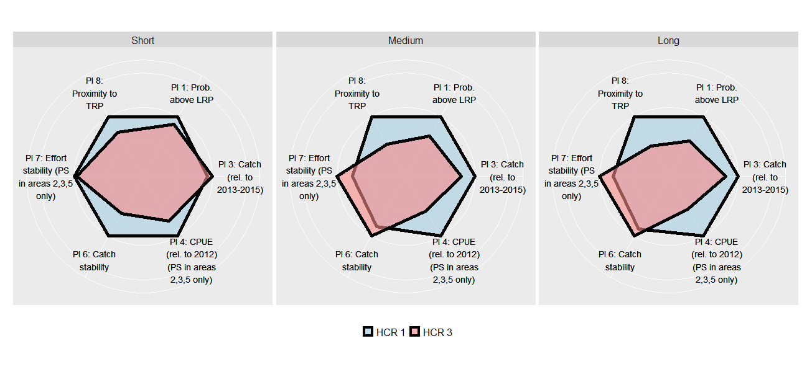
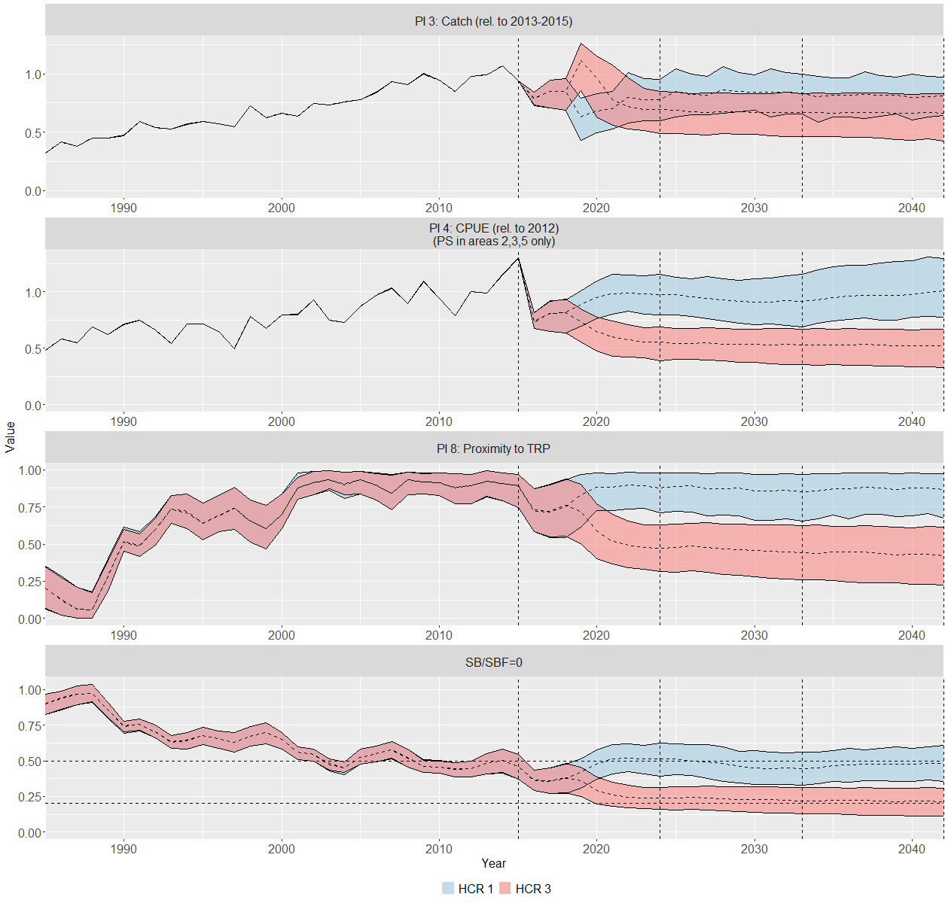
What is the Impact of Compromising Sustainability?

Slide 11
How can Additional Value be Provided through the VDS?
First and foremost the VDS is a fisheries management tool and the value that is currently being derived is a result of the strengthening of the fisheries property rights associated with the VDS.
The VDS is what is known as an inter-transferable quota system (ITQs). There is a lot of literature on the use of ITQs. This provides the opportunity to assess theoretic application of systematic improvements to a functional real world system that is performing exceptionally well.

Slide 12
How can Additional Value be Provided through the VDS?
Strategic
  High seas allocation
  Domesticate value (rights)
  Asset capitalization
  Promotion of ZBM in global fora
Systematic
  Transferability
  Permissioned trading
  Secondary market creation
  Commodity forward contracts

Slide 13
Summary
VDS is a demonstrated successful sustainability tool
The value of sustainability far outweighs the value of compromising
Specialized tools are available to assess the impacts of different policy choices.
Whilst price is a composite of availability and the market, for PNG, increasing the utility of the VDS rather than reducing the price of VDS days made available on the open market circumstance is a sensible approach.

Slide 14
Questions?

